Slide 1
WV DEP – Protocols for Benthic Macroinvertebrate Sampling and Access Database Demonstration
Meeting Agenda
April 1, 2011
8:30 – Introduction - John Wirts - WVDEP
8:45 - Presentation on Benthic Macroinvertebrate Collection Procedures - Jeff Bailey - WVDEP Watershed Assessment Branch
9:30 - Demonstration of revised MS Access based “Database for Contractors and Consultants (including WVSCI calculations) v4.” - Mike Whitman – WVDEP
10:15 – Break
10:25 – Continuation of database demonstration.
11:30 – Lunch (on your own)

Slide 2
Meeting Agenda
Continued:
12:30 - Field Demonstration – Kanawha State Forest, mouth of Log Town Hollow. Will review and demonstrate benthic macroinvertebrate sampling equipment; collection; and field processing of samples.
1:30 - Personnel from DEP’s Division of Mining and Reclamation will be available to discuss issues related to their 2010 permitting guidance, including Biological Assessment Station (BAS) setup.
~ 4:00 pm – Adjourn.

Slide 3
WV DEP – Protocols for Benthic Macroinvertebrate Sampling and MS Access Database Demo – CD Reminder
PPT Presentation of Benthic Macroinvertebrate Sampling Protocols – on CD
WVDEP - MS Access Database v4 for Data Storage and WVSCI calculation with users manual – on CD
WVDEP - Benthic Macroinverterbate Sampling Protocols from Watershed Branch SOP – 2011 – on CD
Sign-up Sheet – on the back table
Map and Driving Directions to KSF – on the back table

Slide 4
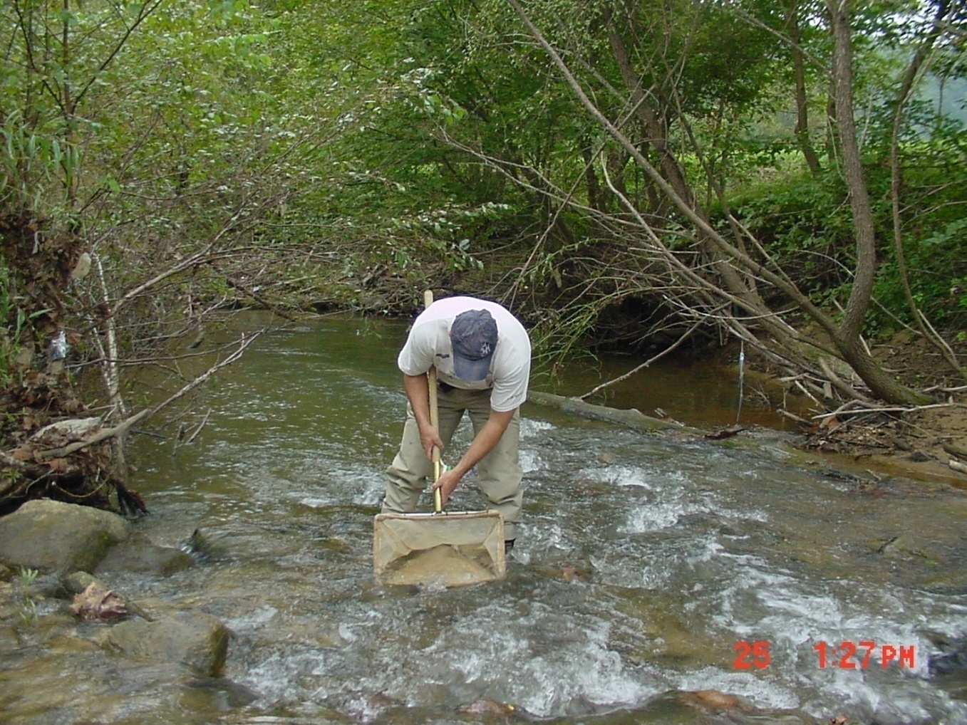
Benthic Macroinvertebrate Sampling Protocols for Riffle/Run Streams in West Virginia
April 1, 2011
WV Department of Environmental Protection
Watershed Assessment Branch
(304) 926-0499
Jeffrey.E.Bailey@wv.gov

Slide 5
Description of Terms
Watershed Assessment Branch – WAB
Benthic Macroinvertebrate Sample – “Bug Sample”
WV Stream Condition Index – WVSCI
(“Wev – Skee”)
Comparable – refers to bug sample that was collected and processed in a manner that makes the resultant data appropriate for WVSCI calculation.

Slide 6
West Virginia Department of Environmental Protection
Watershed Assessment Branch
2010 Standard Operating Procedures
Table of Contents
    Introduction to Watershed Assessment Branch Sampling Activities
    Instructions For Completing The Stream Assessment Form
    Global Positioning Systems (GPS)
    Water Quality Sondes: Calibration, Maintenance, & Use
    Water Quality Sample Collection, Handling and Analysis
    Field Blanks and Duplicates
    Photography
    Benthic Macroinvertebrate Collection Protocols
    Processing Macroinvertebrate Samples
    Identification of Macroinvertebrates, Taxonomic References, and Data Analysis, WVSCI
    Periphyton
    Measuring Stream Flow (Including Maintenance & Use)
    Substrate Characterization & Gradient Measurement or Relative Bed Stability
    TMDL Source Sampling
    Ambient Water Quality Sampling

Slide 7
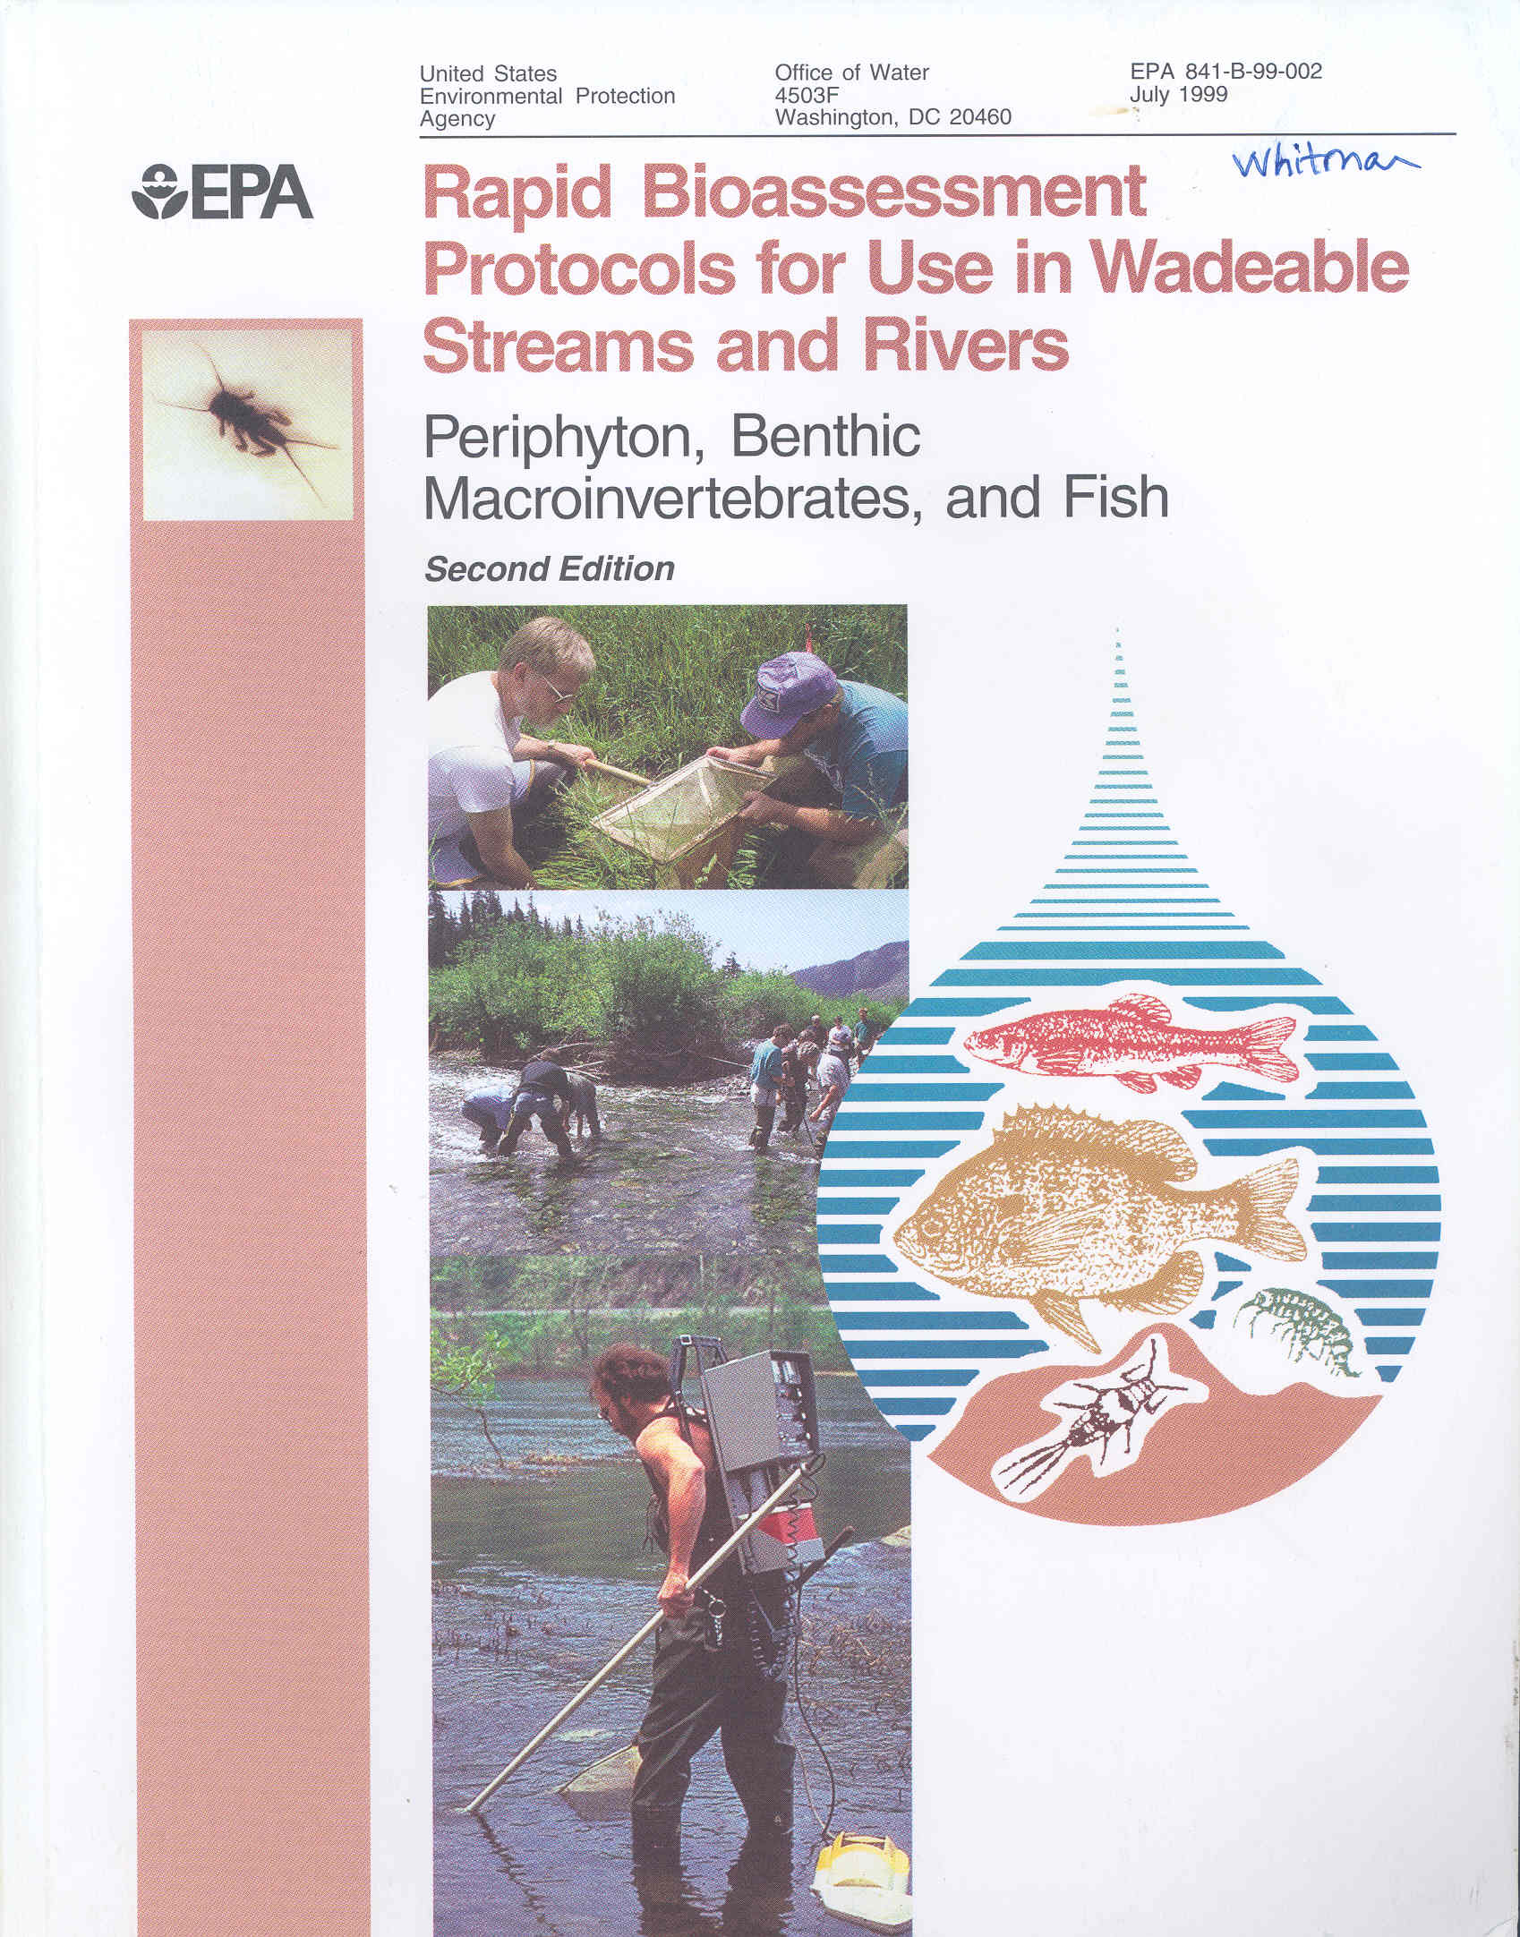
DEP -Watershed Assessment Branch (WAB) was established in 1996.
Primary goal of WAB is to assess the quality of WV stream, rivers, and lakes and report the findings to US EPA in – Integrated Water Quality Monitoring and Assessment Report includes 303(d) and 305(b).
Assessment protocols were based on US EPA RBP’s with only a few minor adjustments through the years.
Currently, more than 7,000 benthic macroinvertebrate samples are stored in WAB Database.

Slide 8
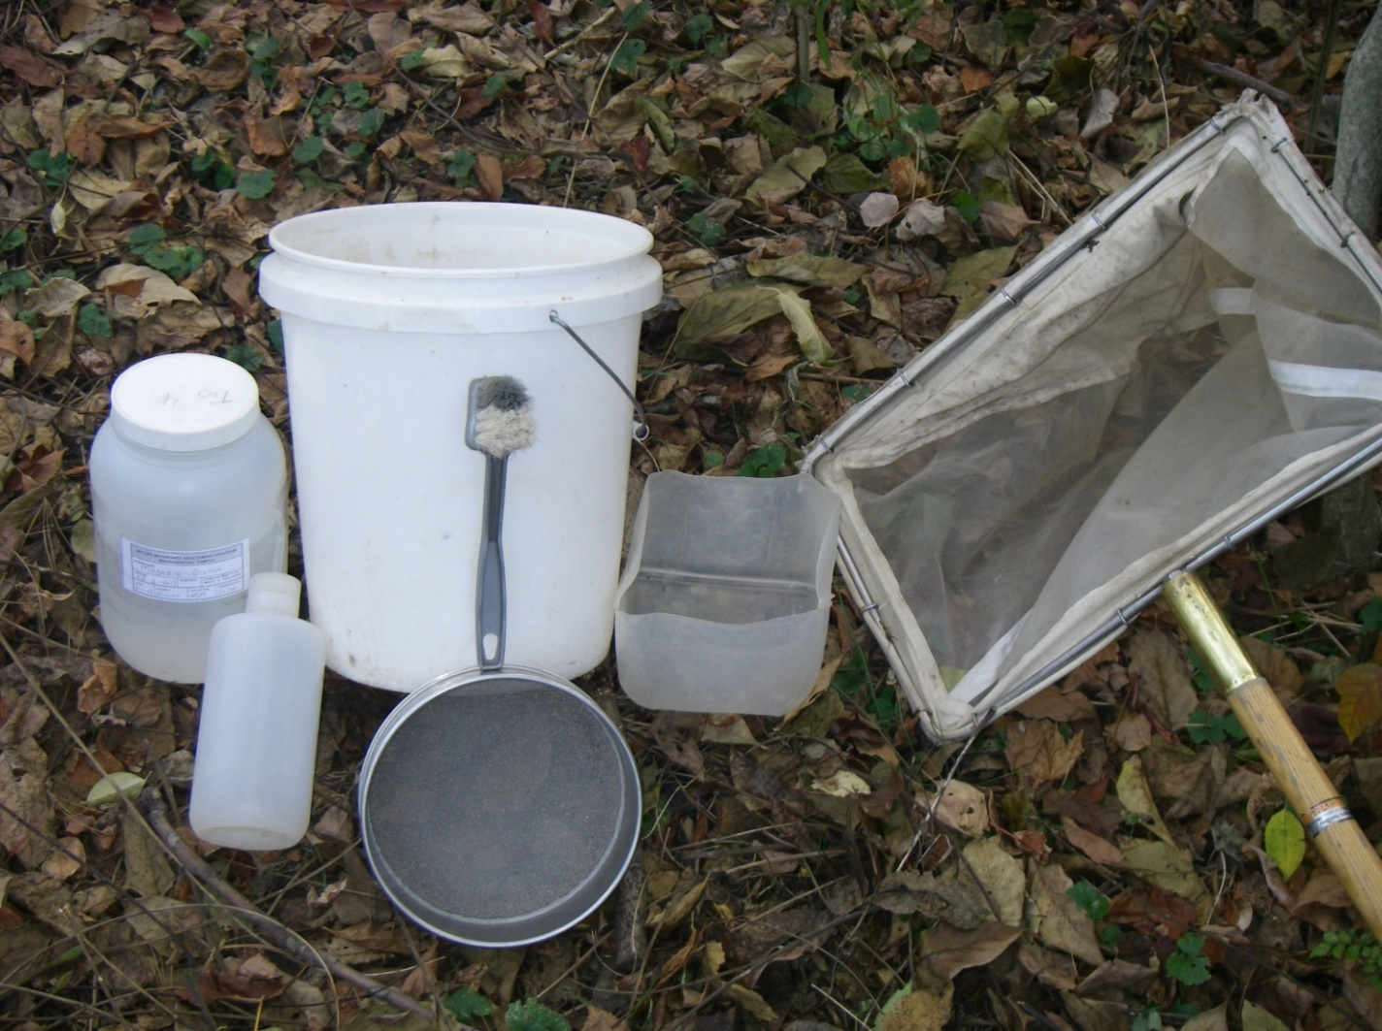
BENTHIC MACROINVERTEBRATE COLLECTION EQUIPMENT
Rectangular Frame Kicknet (600 µm)
Five-gallon bucket
30 mesh sieve (600 µm)
Small dish washing scrub brush
Small plastic container or tray
Gallon-sized sample jars
Inside and outside labels
Fine-tipped forceps
One liter squirt bottle
95% Denatured ethanol
Ice chest / cooler

Slide 9
Rectangular frame kicknet
D-frame Dipnet
600 µm mesh
0.3m

Slide 10
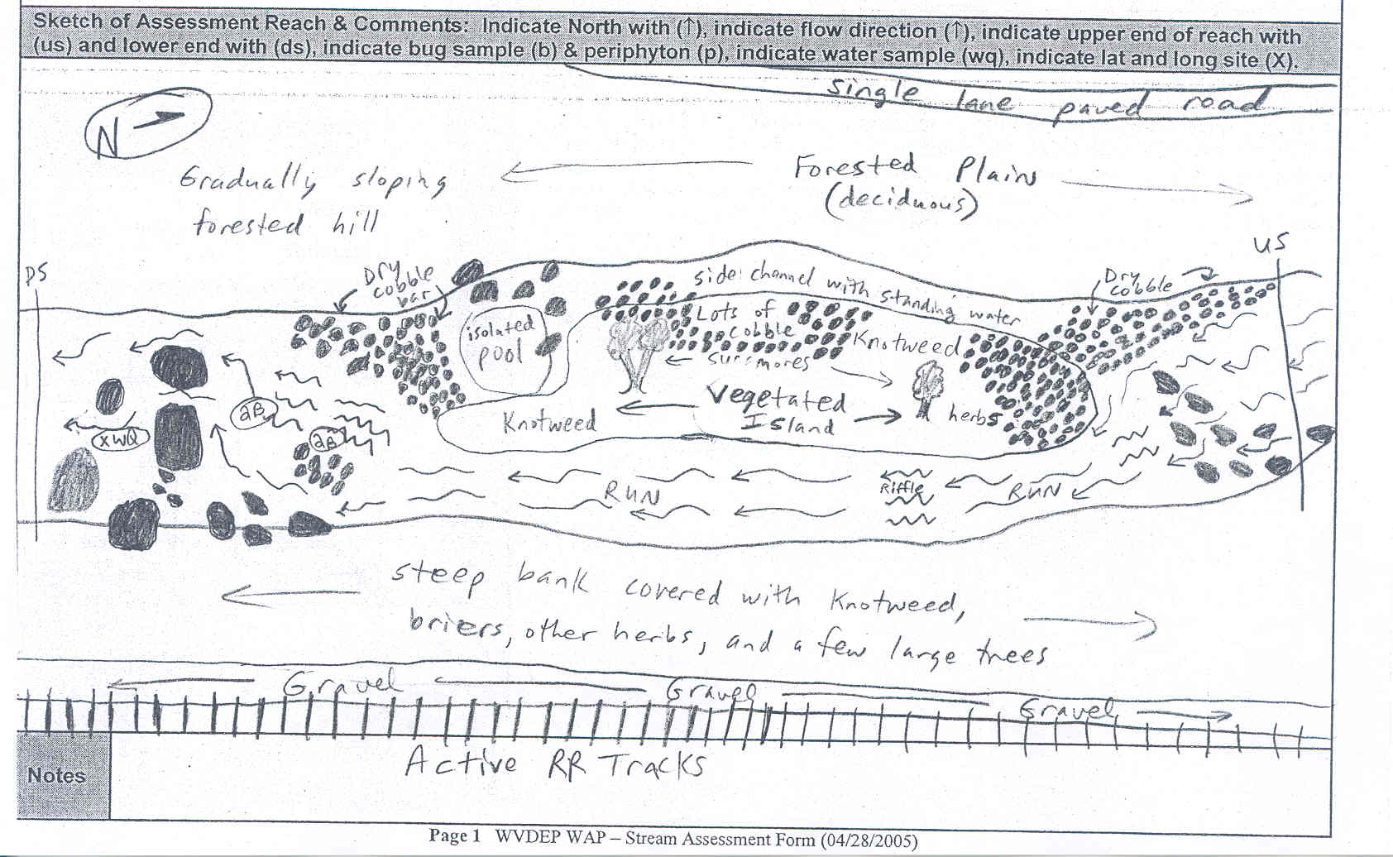
100 meter assessment reach

Slide 11
Sample Most Productive
Riffle/Run Habitat
Cobble dominated riffle would be selected over a coarse gravel dominated riffle
Substrate Classification
Class | Code | Size | Description
Bedrock | BR | >4000 mm | Bigger than car
Boulder | BL | >250-4000 mm | Basketball to car
Cobble | CB | >64-250 mm | Tennis ball to basketball
Coarse Gravel | CG | >16-64 mm | Marble to Tennis ball
Fine Gravel | FG | >2-16 mm | Ladybug to marble
Sand | SA | >0.06-2 mm | Gritty between fingers
Silt & Fines | ST | <0.06 mm | Smooth, not gritty (silt & muck)
Clay | CL | >4000 mm | Slick/hard clay or hard-pan clay bottom

Slide 12
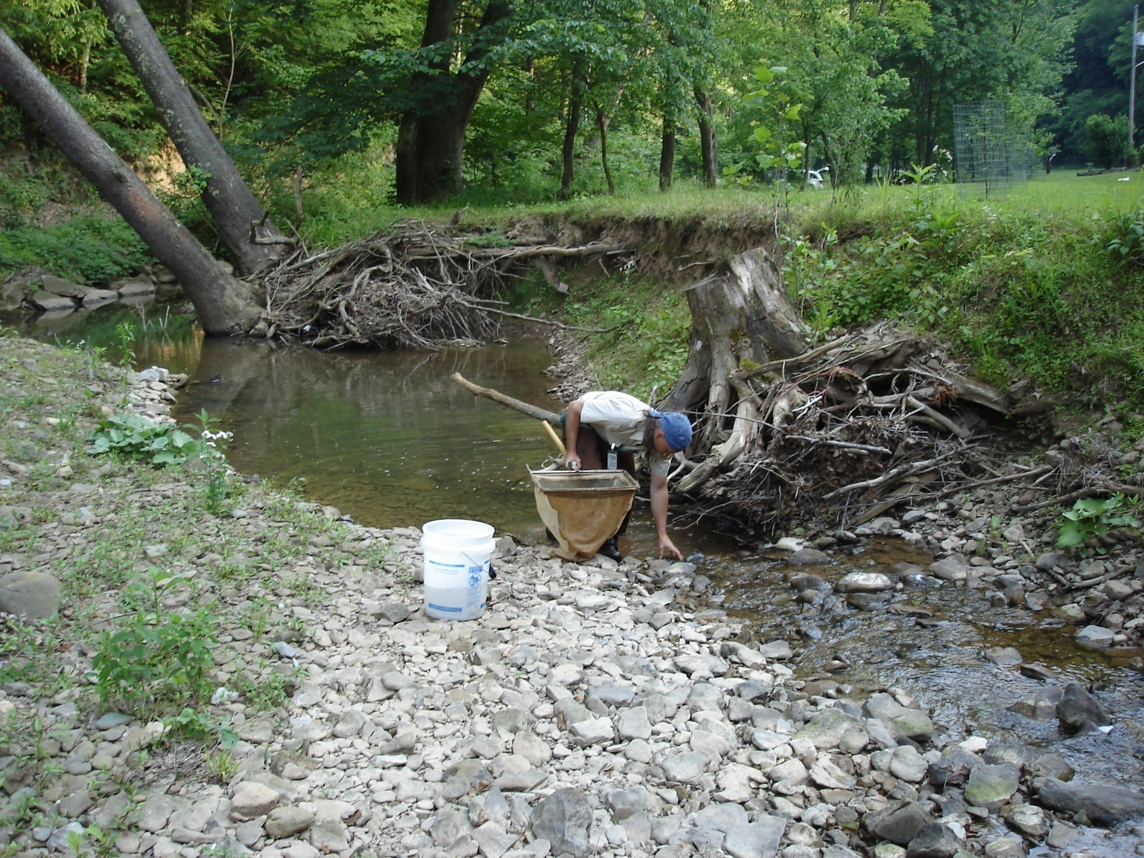
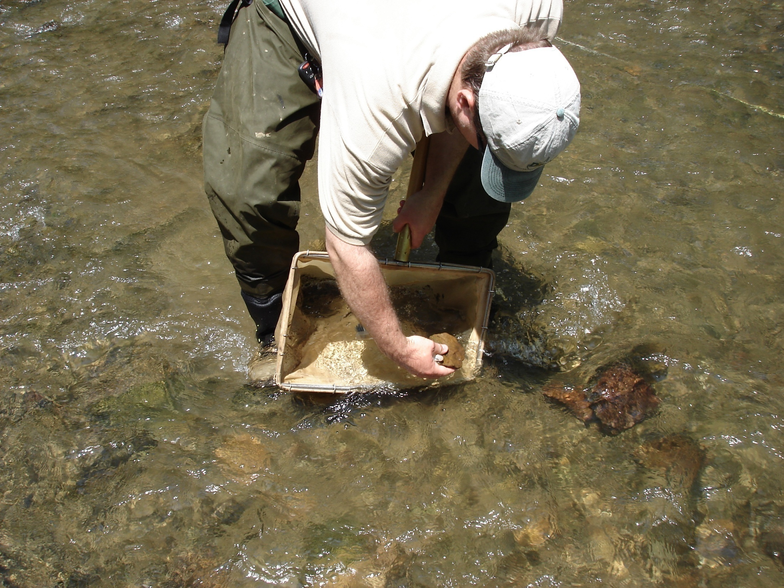
Remove objects to firmly seat net on bottom

Slide 13
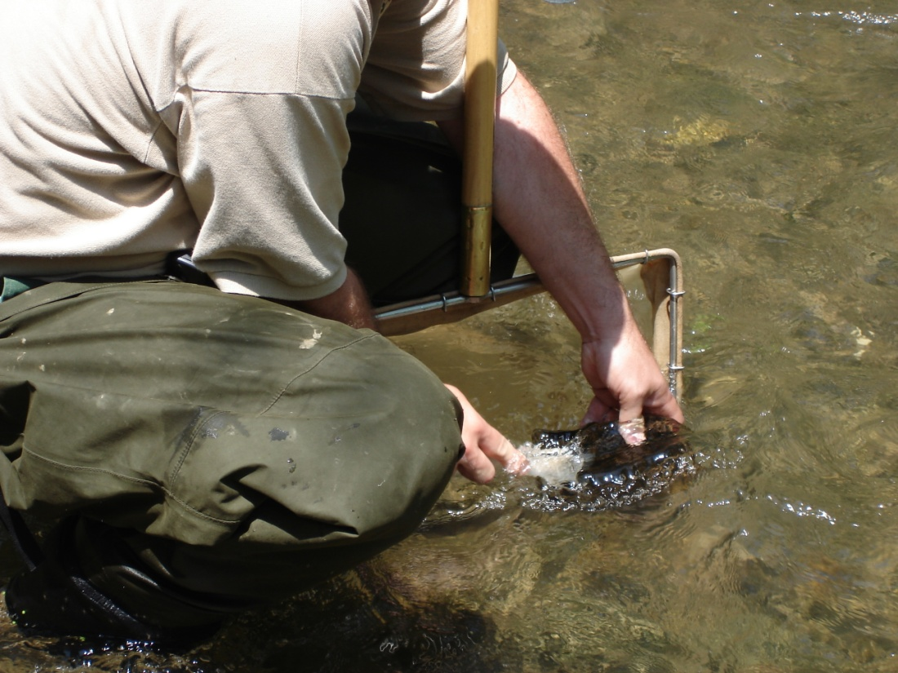
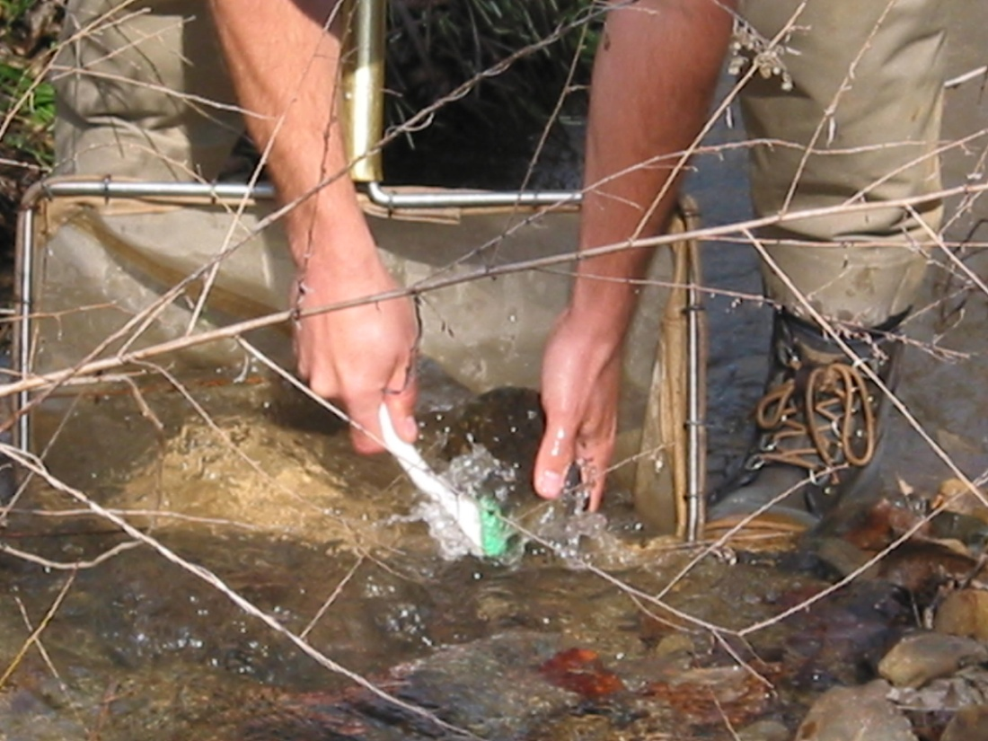
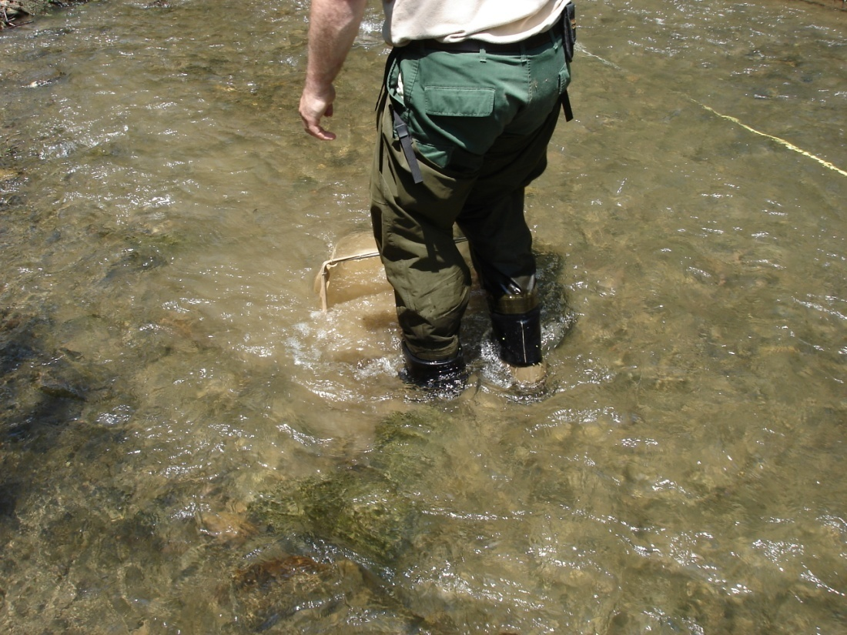
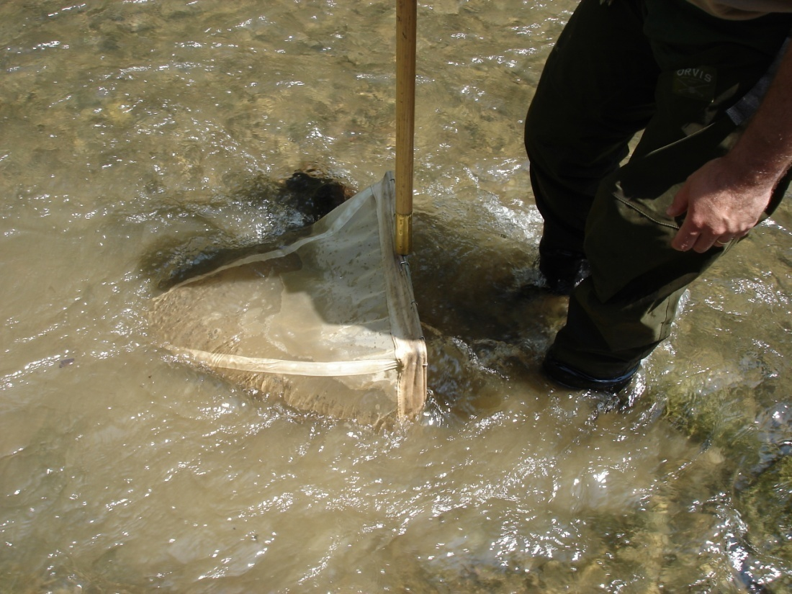
Use brush to scrub coarse gravel and larger
Kick substrate 20 seconds in 0.25m² area in front of net to a depth of about 10 cm

Slide 14
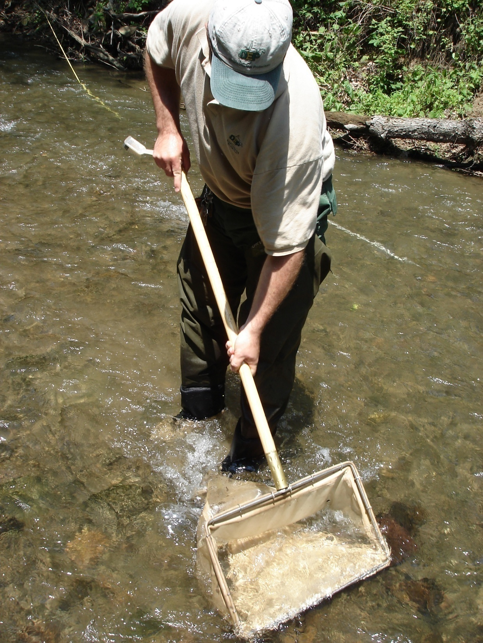
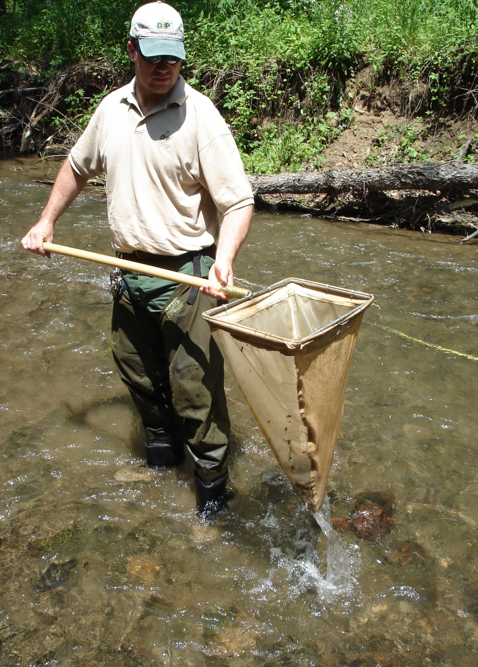
Lift net out using upstream motion

Slide 15
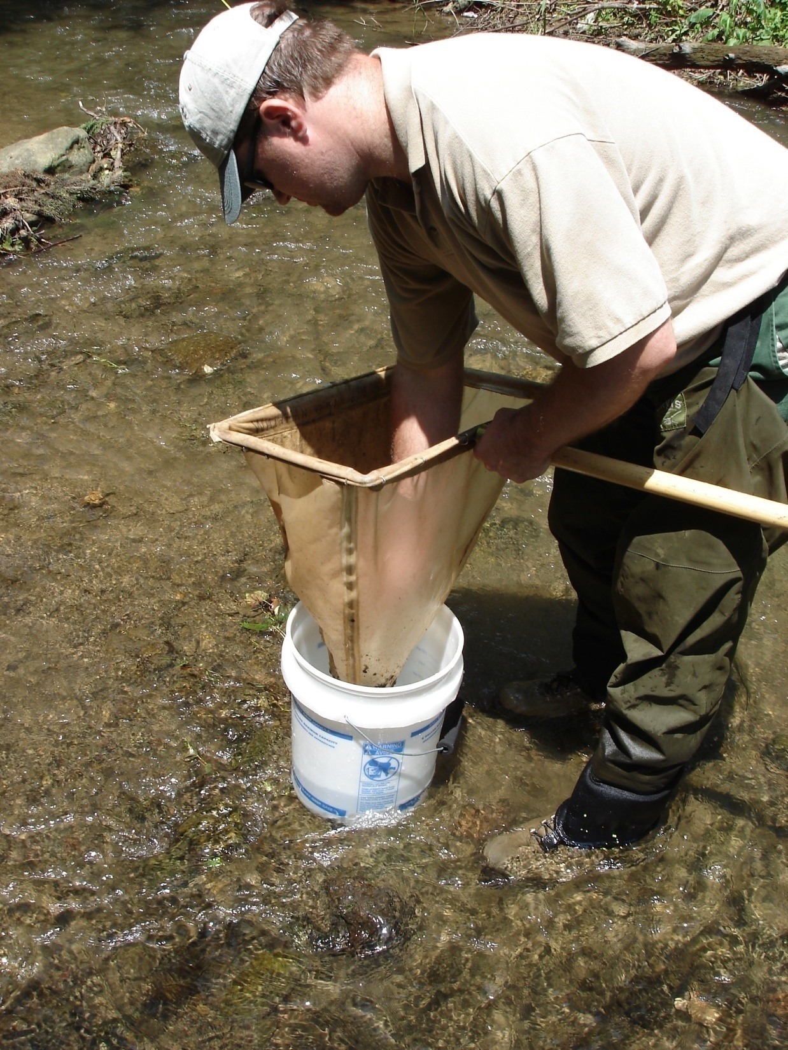
Composite 4 kicks into bucket

Slide 16
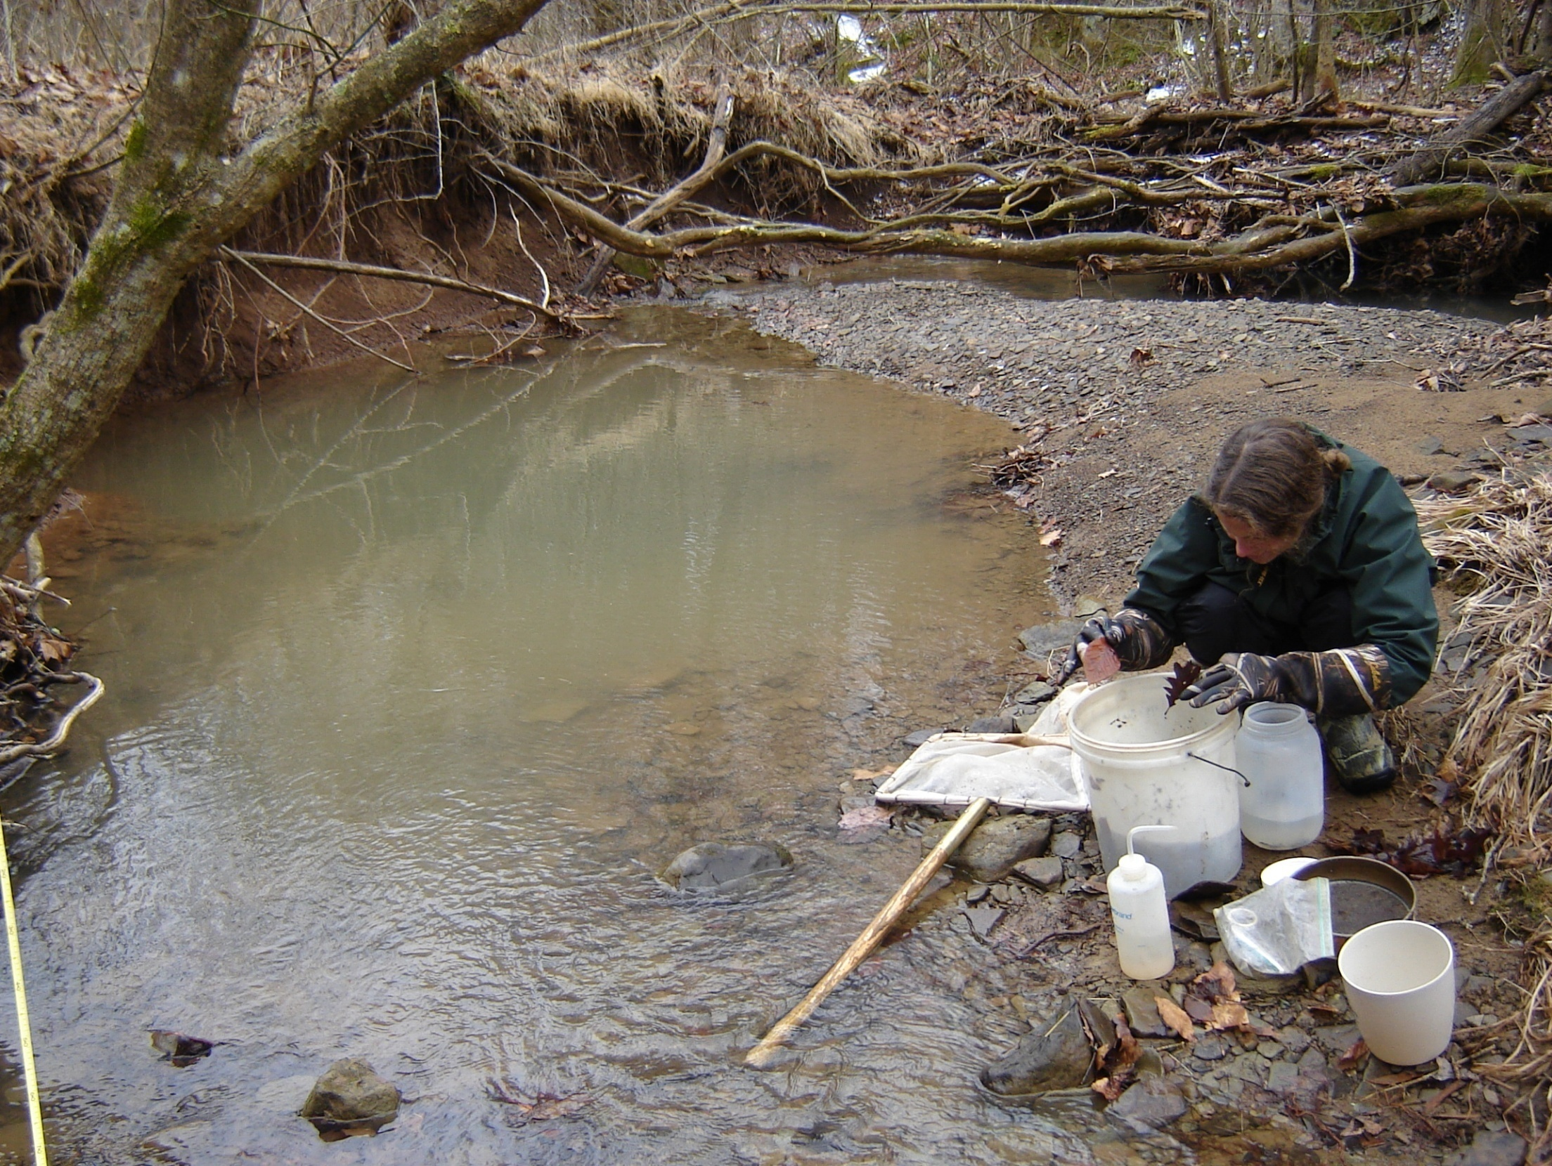
Clean and discard large objects

Slide 17
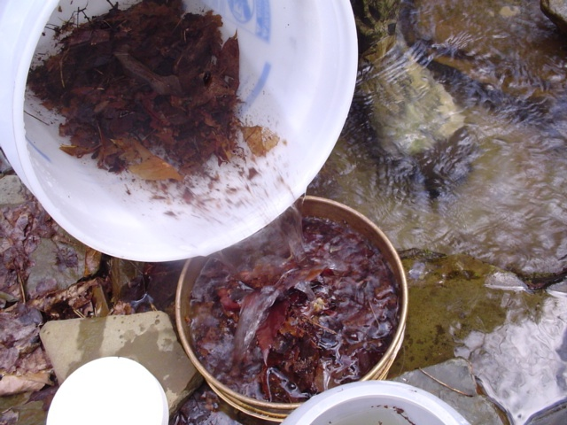
Elutriate soft materials into sieve

Slide 18
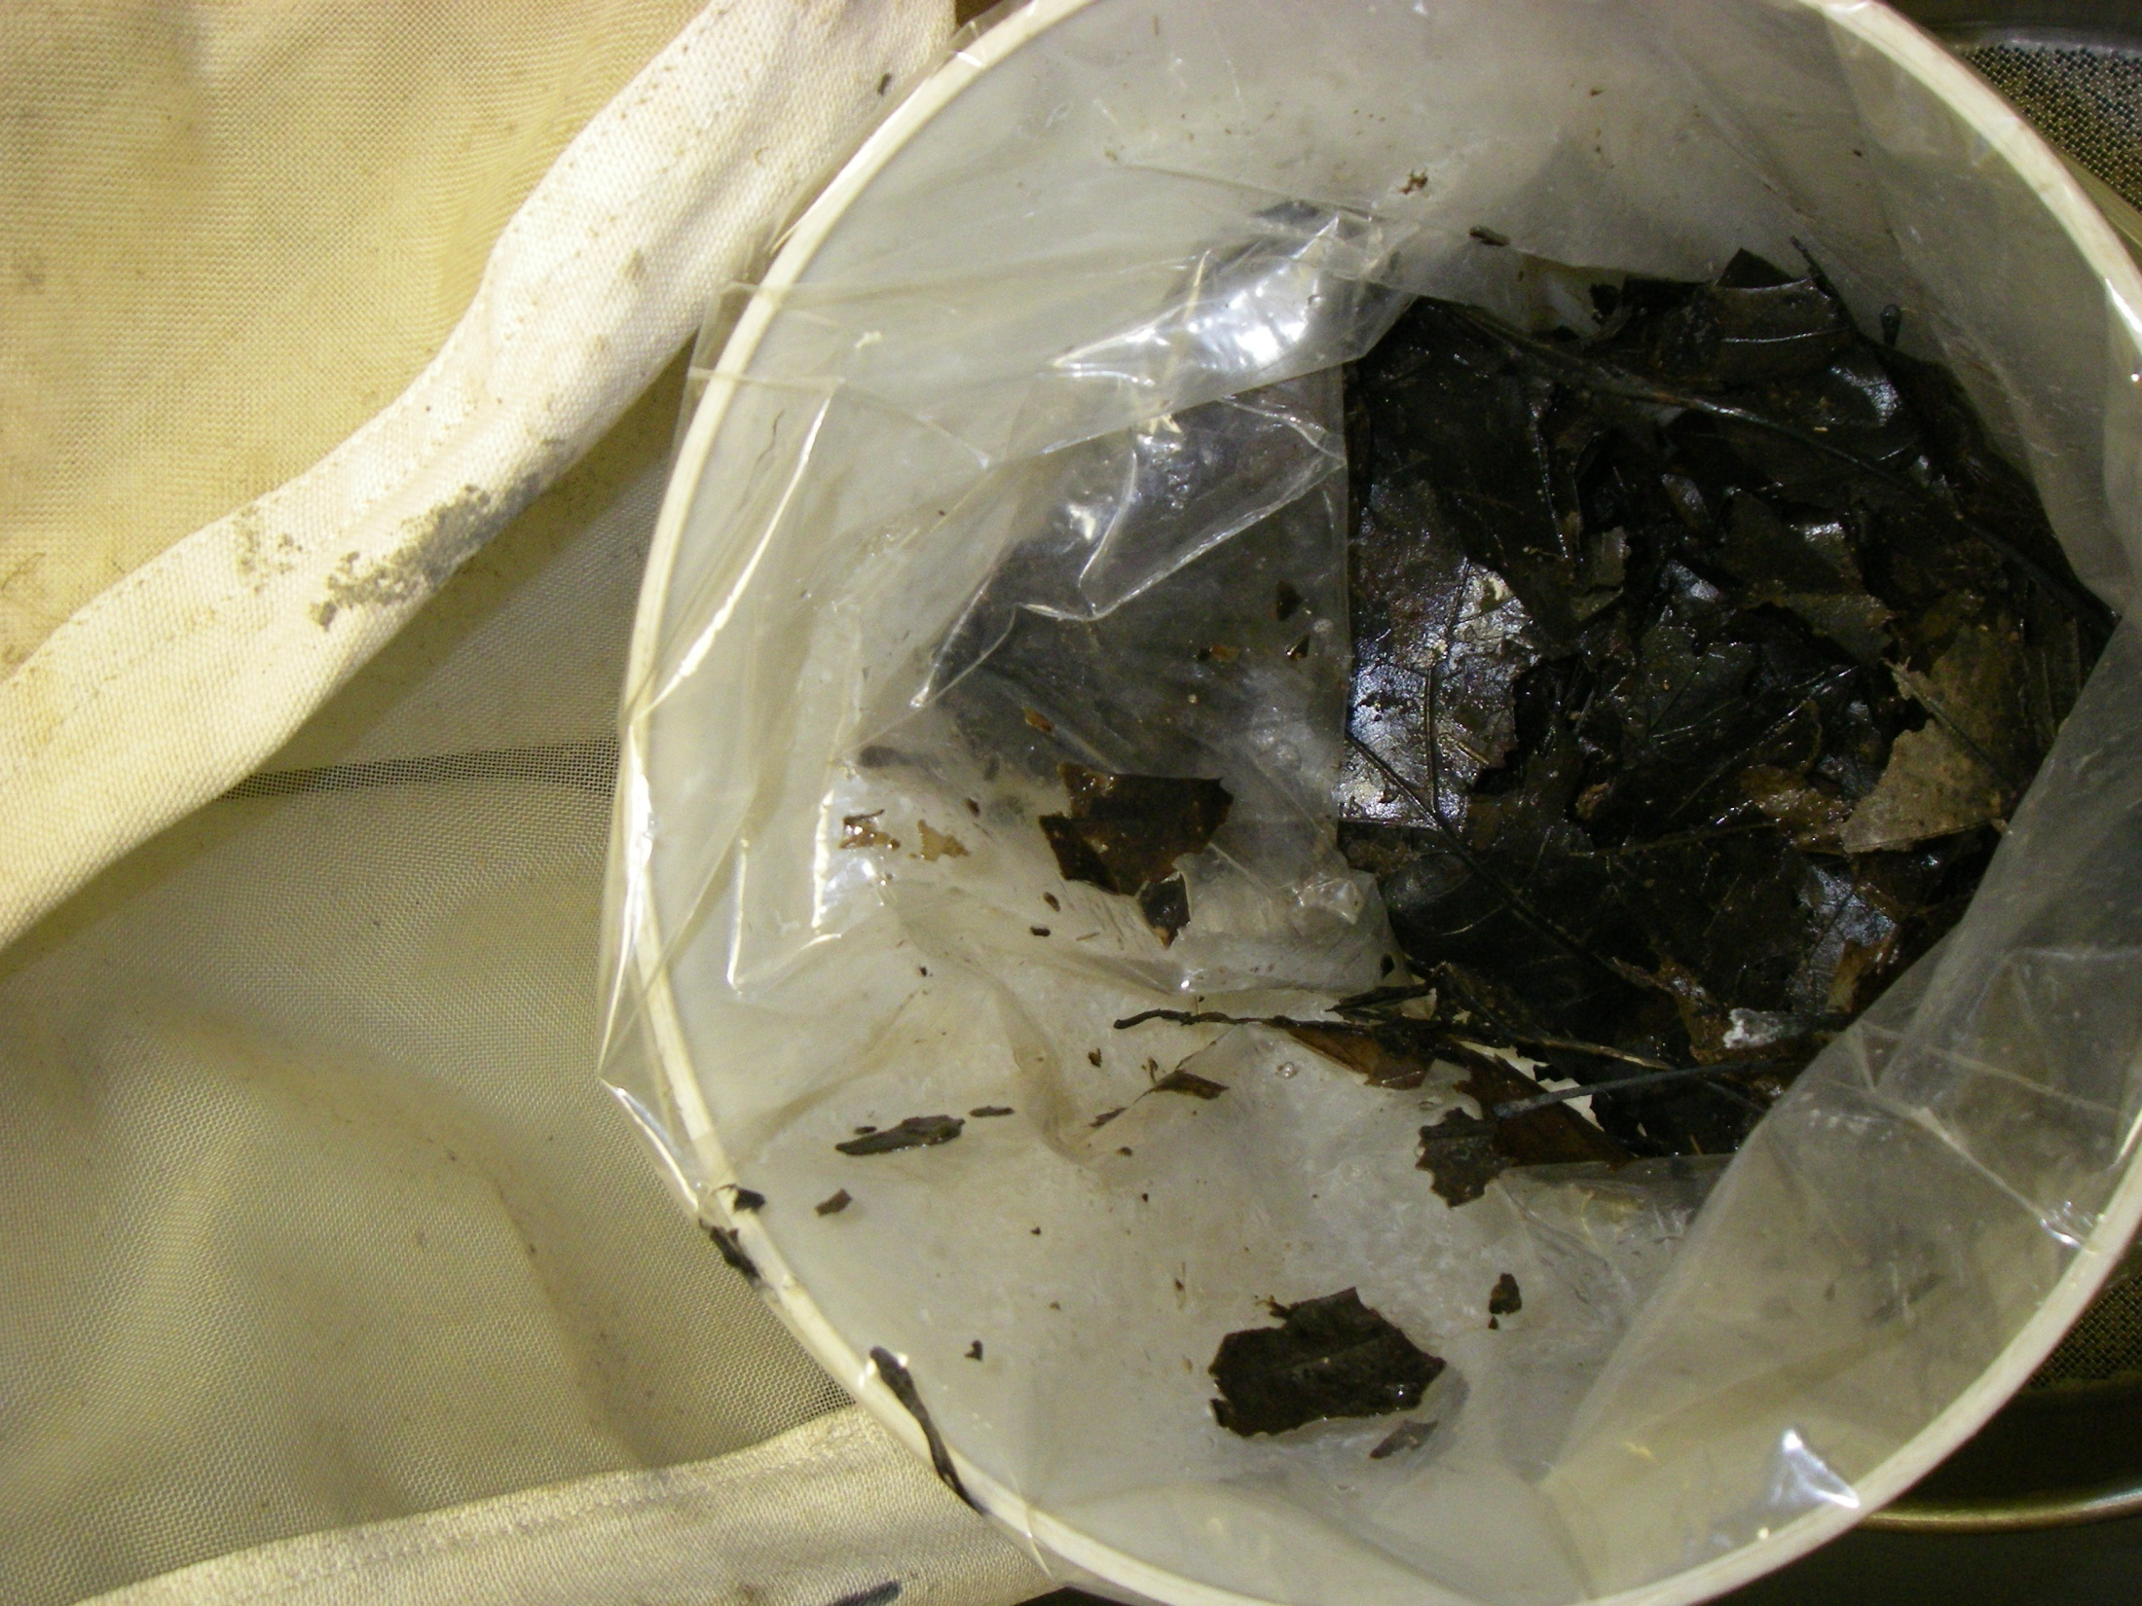
Transfer soft materials from sieve to temporary container

Slide 19
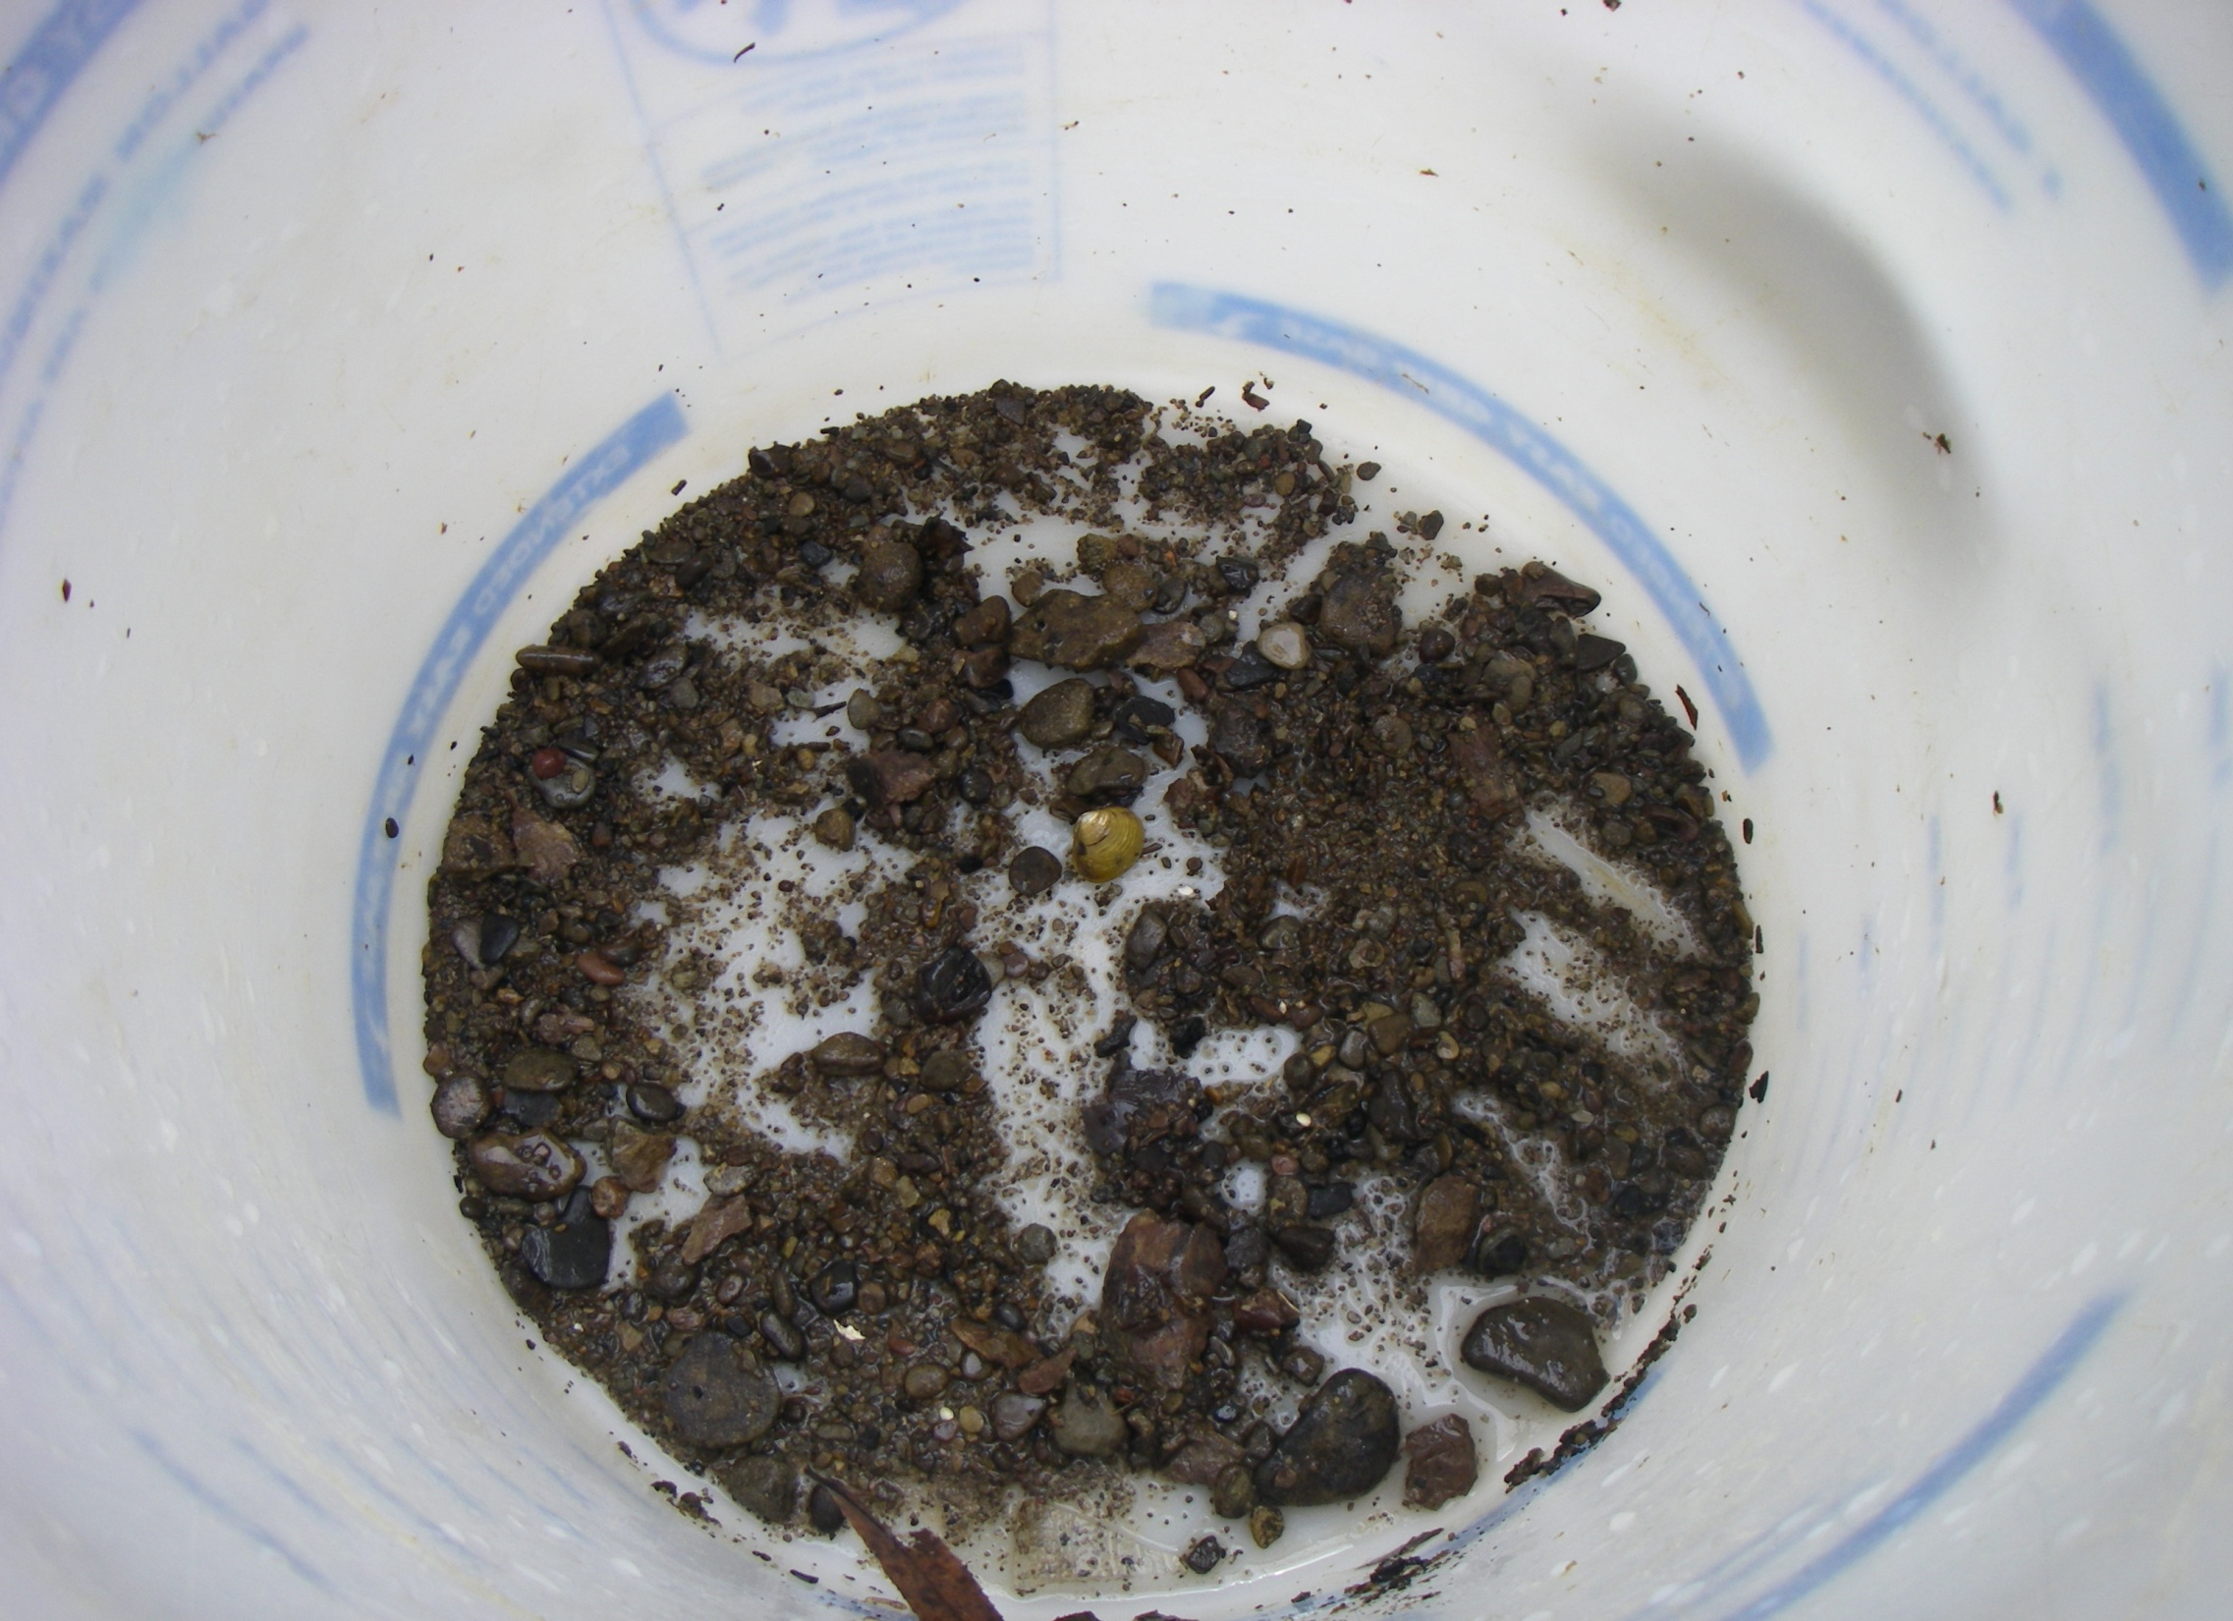
Heavy materials (sand, gravel, and corbicula) remain in bucket after elutriating soft materials.

Slide 20
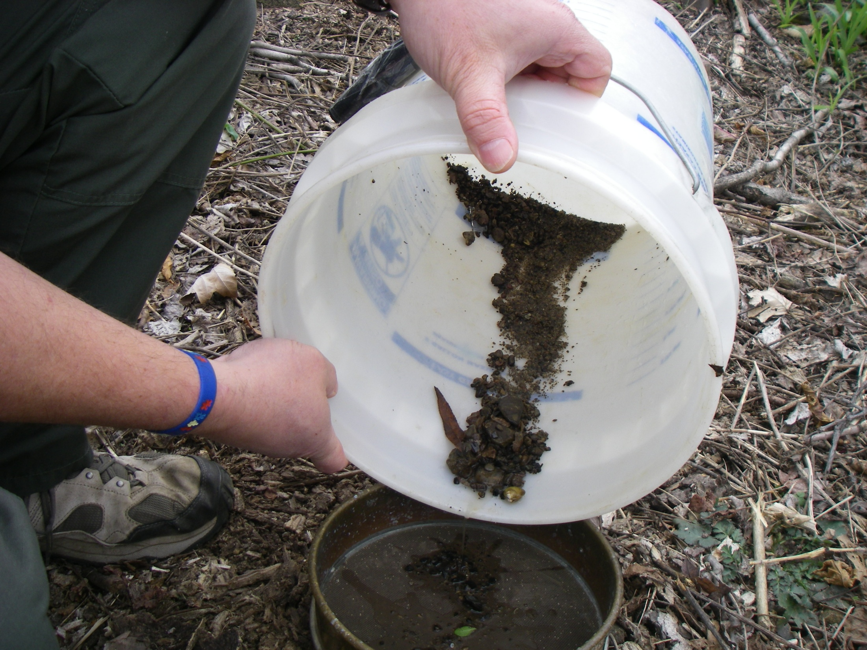
Pour heavy material into sieve for cleaning

Slide 21
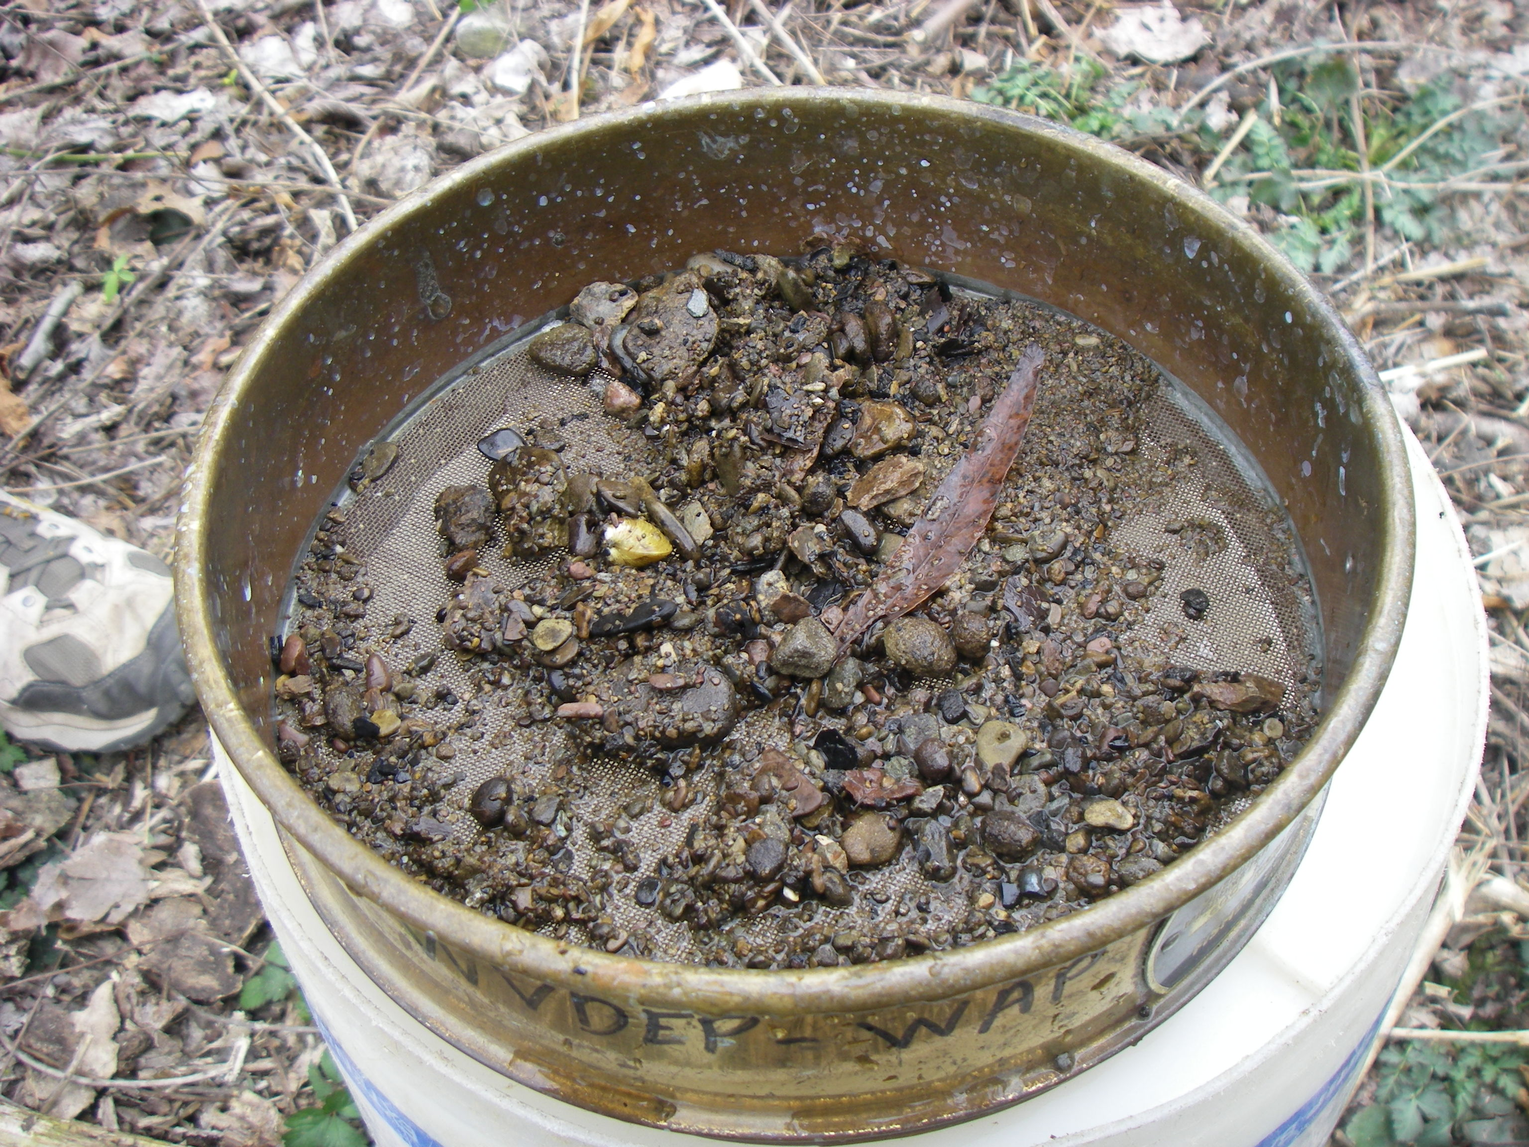
Clean heavy materials by dipping sieve into stream repeatedly

Slide 22
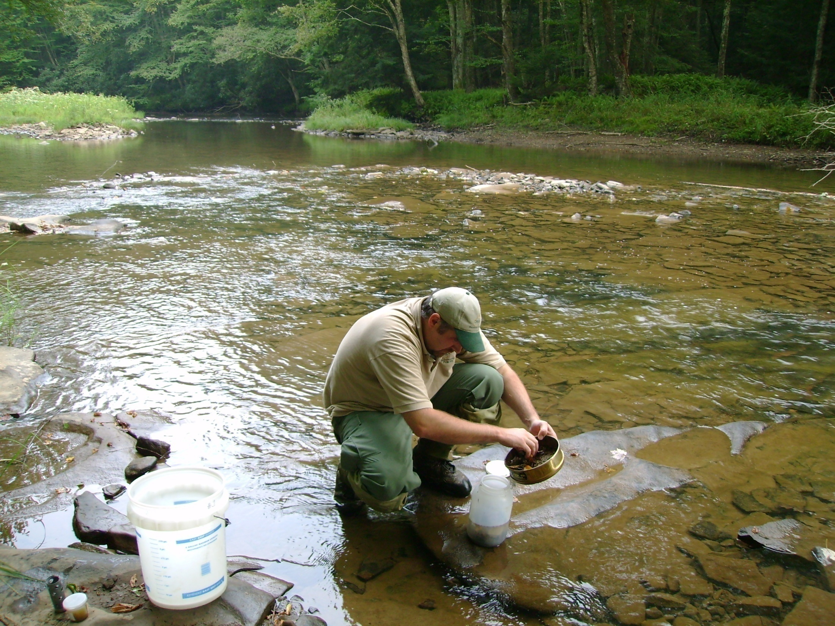
Transfer heavy materials (sand, gravel, corbicula) into sample jar first

Slide 23
Transfer soft materials from temporary container to sample jar

Slide 24
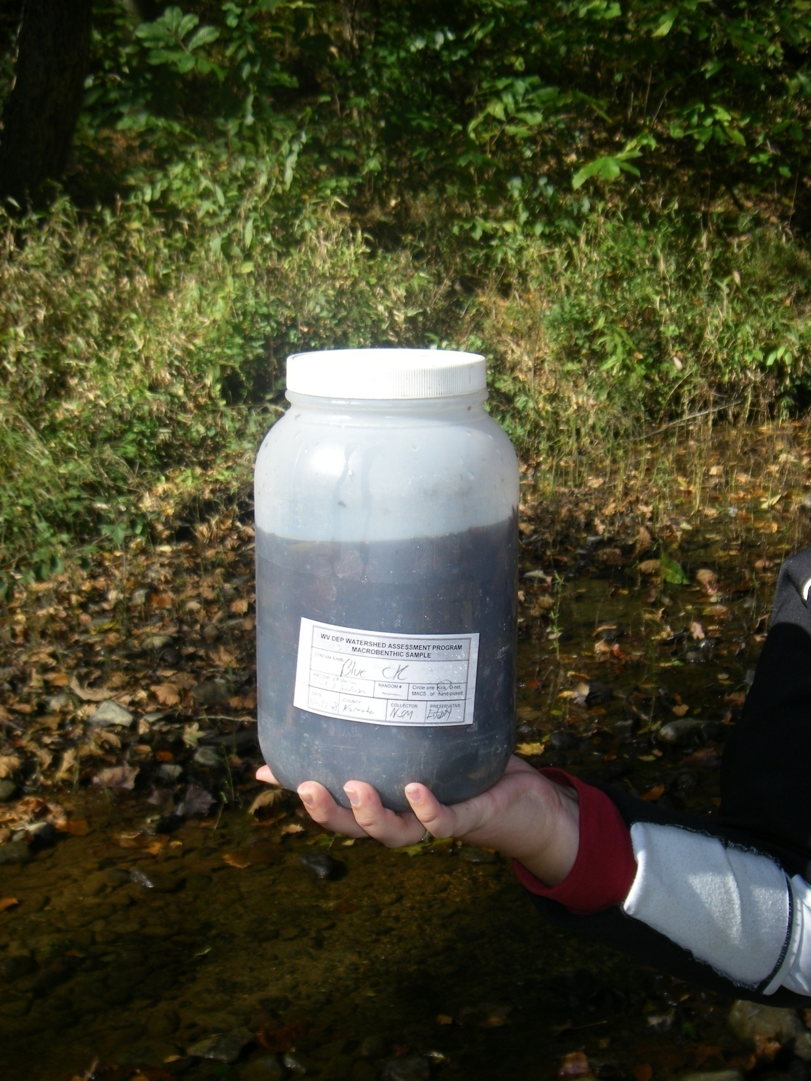
Soft materials “bugs” on top
Heavy “sand & gravel” on bottom

Slide 25
Factors and conditions that may influence sample comparability and WVSCI
Drought influenced streams
Low flow conditions
Severe floods/spates
Sampling outside of thalweg
Sampling in habitats that are too deep
Sampling pools, undercut banks, LWD
Sampling outside of WVSCI index period
Sampling in turbid water

Slide 26
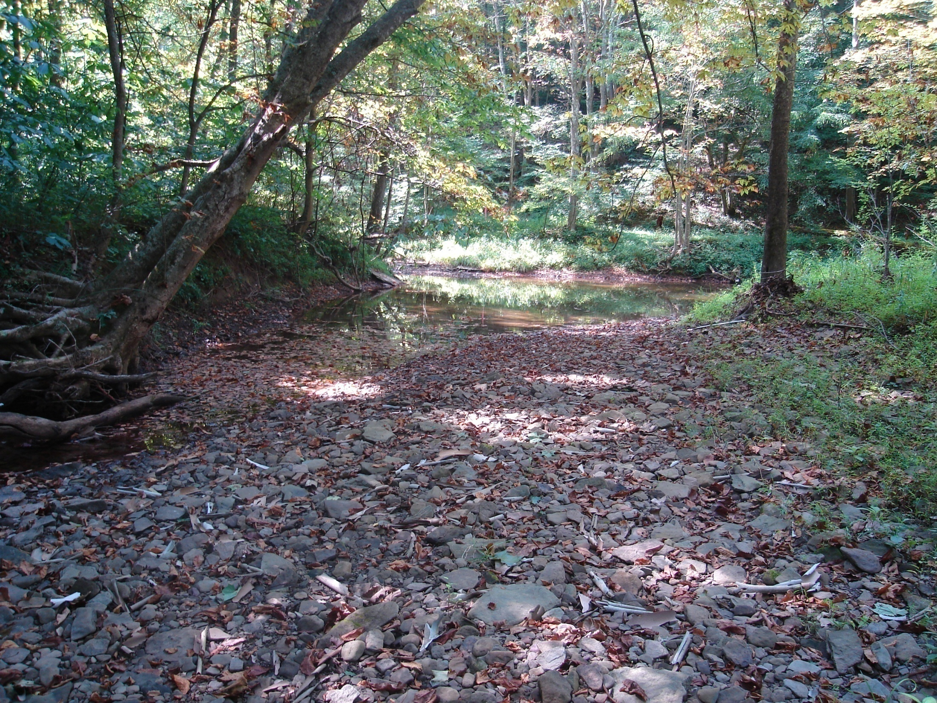
Avoid: Sampling after drought

Slide 27
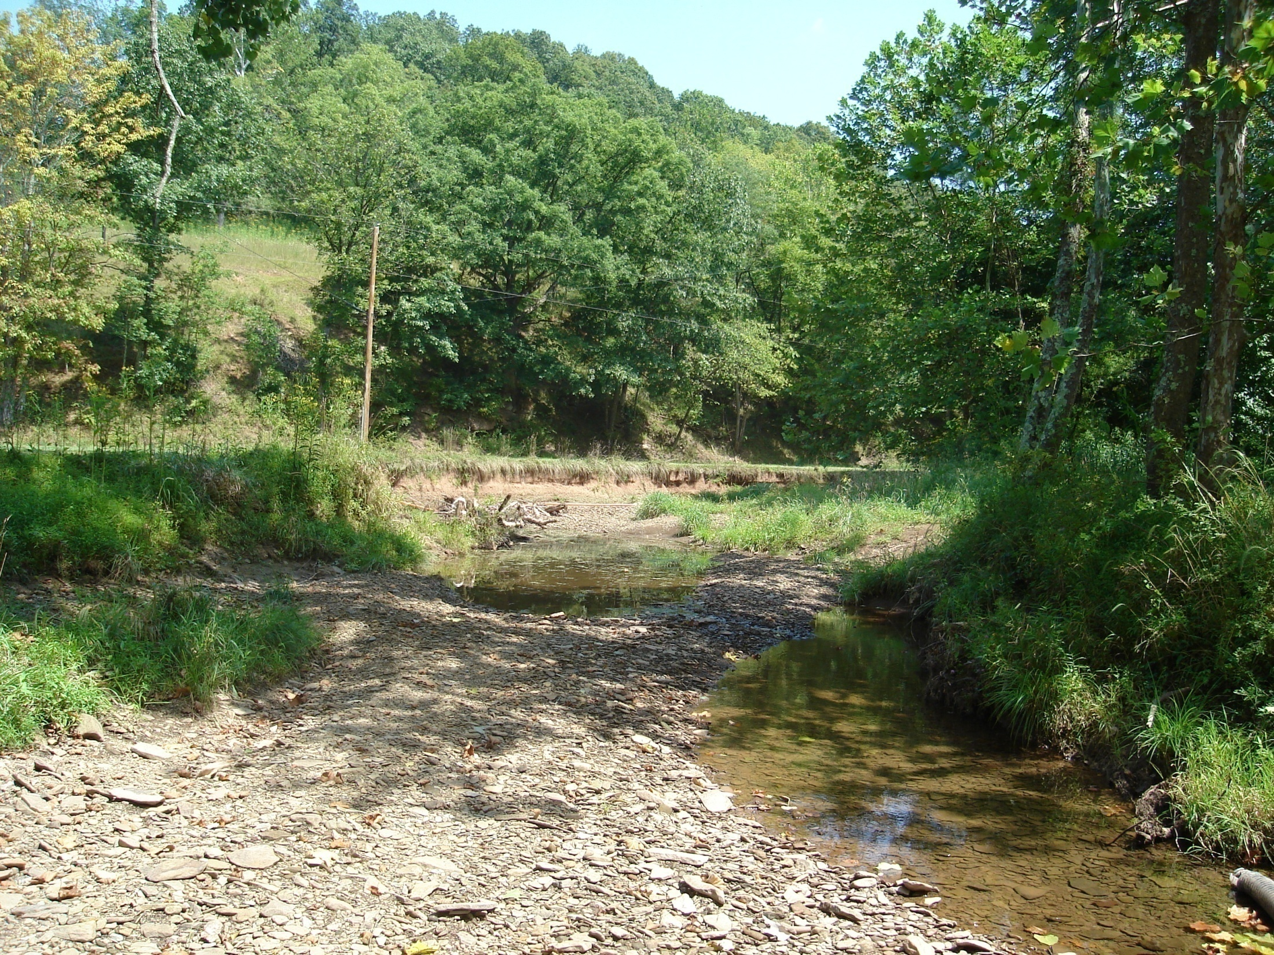
Avoid: Low flow sampling

Slide 28
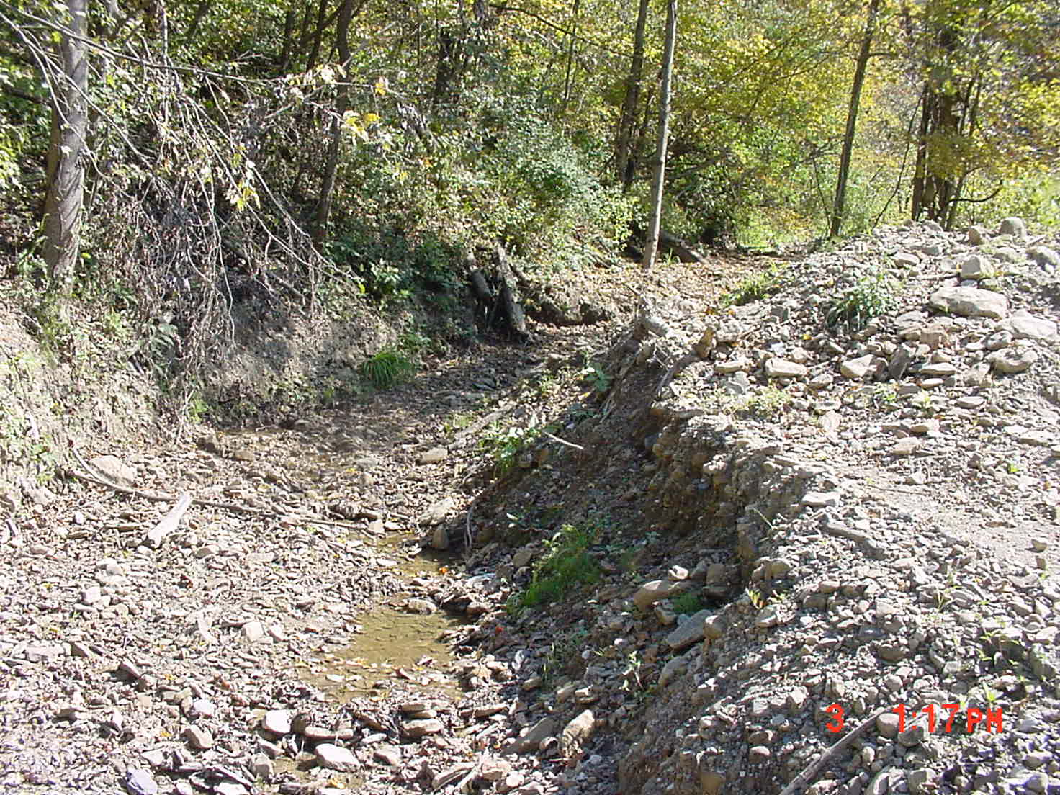
Avoid: Sampling after heavy scour, dredging

Slide 29
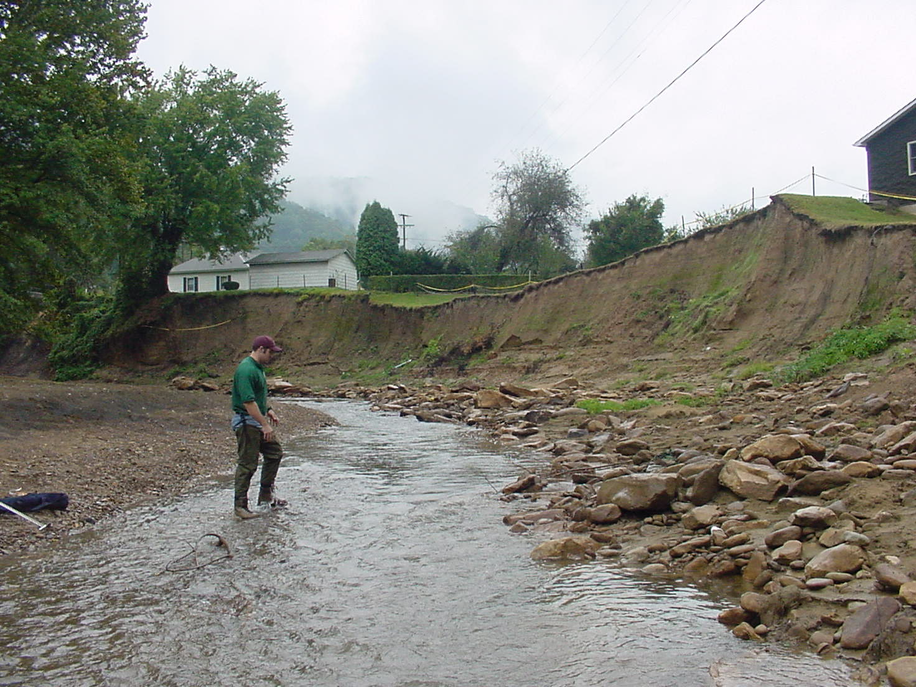
Avoid: Sampling after heavy scour, flood

Slide 30
LAB PROCESSING OF BENTHIC MACROINVERTEBRATE SAMPLES
Tape
Pencil
Crucible - or other small container, is used for short term, intermediate storage of the sample during the picking process.
Forceps
Illuminated magnifier
Squirt bottle
Plexiglas lid - used to cover sample overnight to prevent evaporation.
Counter
Sample jar
Sample vial
Enamel pans
Denatured ethanol
# 30 sieve
Coarse sieve (10mm)
Gridded sorting tray -The internal dimension of the tray is 40 inches by 10 inches. There are 100 grids in the tray and each is 2 inch by 2 inch in dimension.
Cookie cutter – optional
Labels

Slide 31
Laboratory Cleaning Procedures
Pour sample through coarse sieve
Inspect and wash coarse materials
10 mm mesh

Slide 32
Laboratory Cleaning Procedures
Rinse fine particulates from sample
Plastic 600 µm mesh funnel sieve
Standard #30 sieve

Slide 33
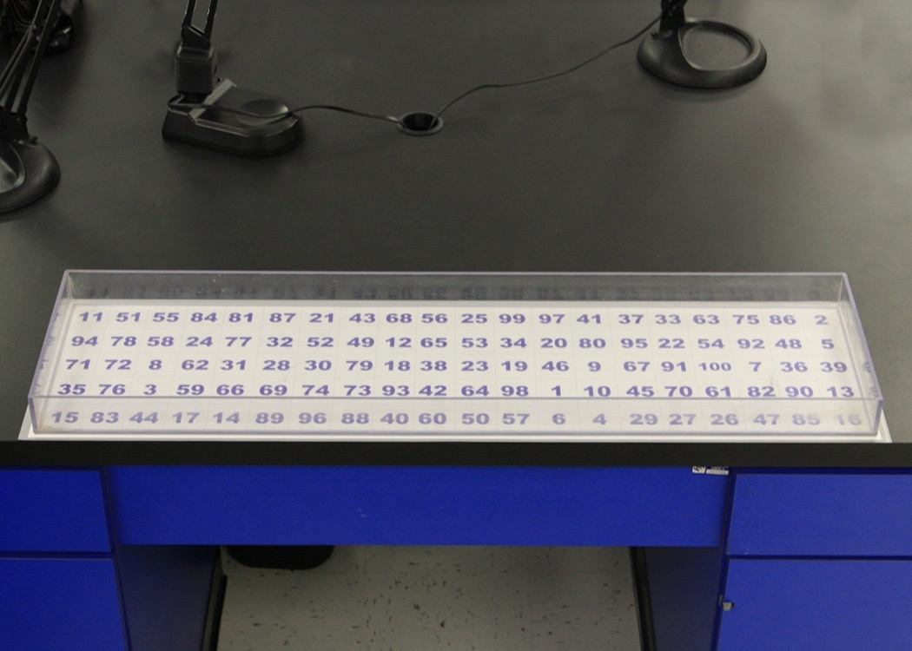
- Home-made Plexiglas Framed or (Plastic) sorting tray
(10 X 40 inches) with gridded bottom (100 - 2 X 2 inch grids)
-White board randomly marked with numbers 1 to 100

Slide 34
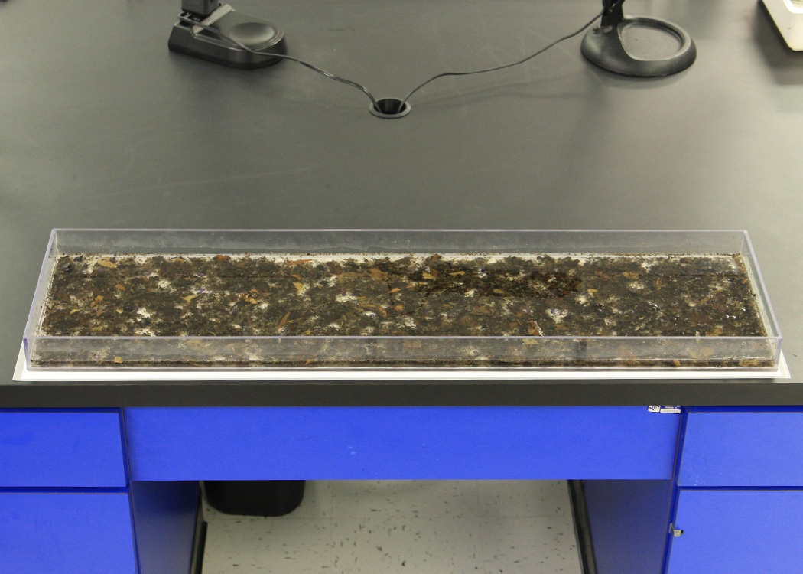
Sample evenly distributed in sorting tray.

Slide 35
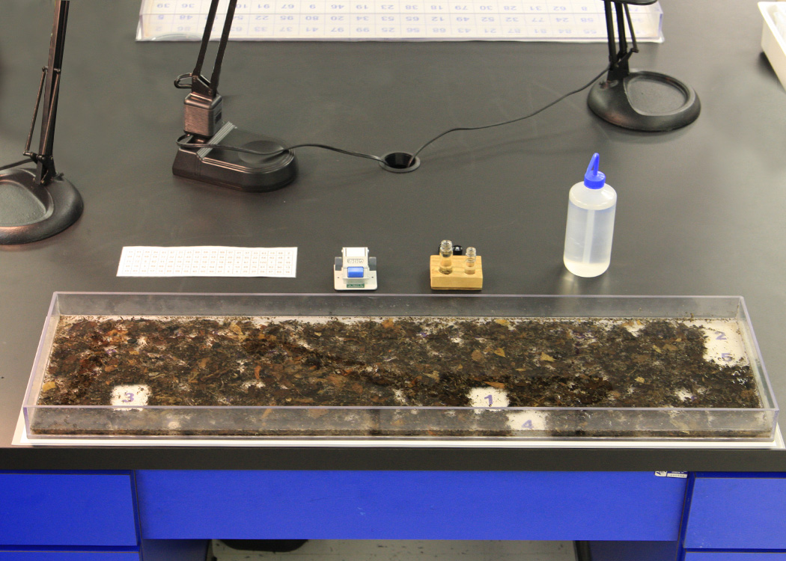
5 grids subsampled from sorting tray.

Slide 36
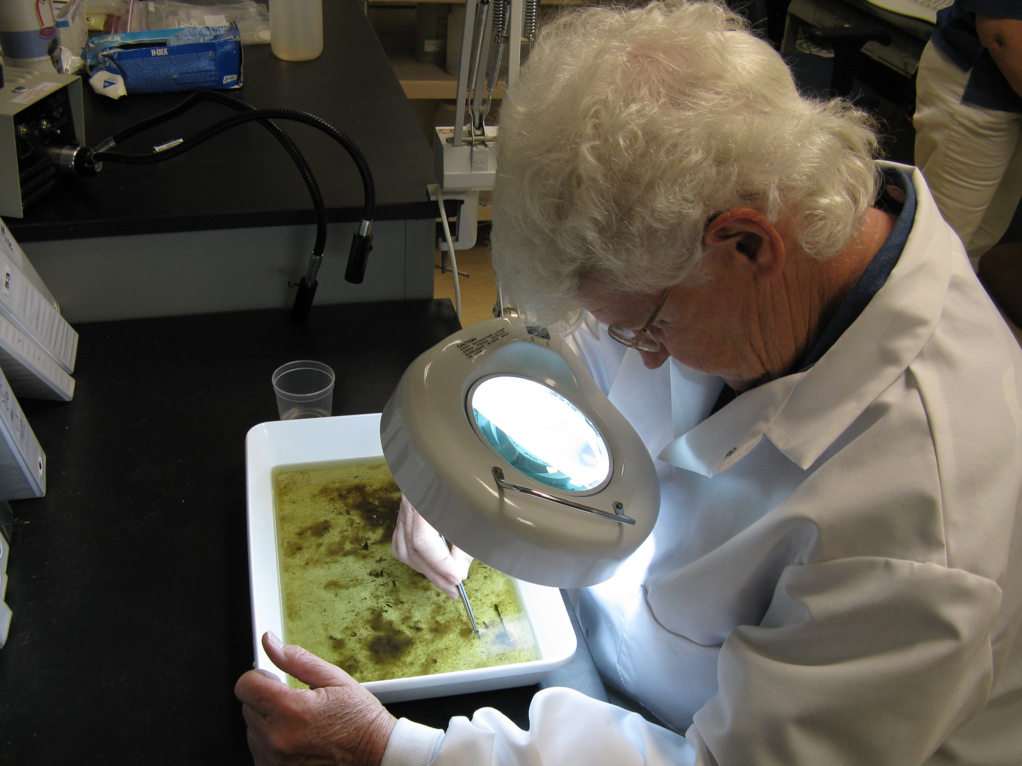
10x Lighted Magnification
for picking

Slide 37
DEP WAB Sorting Criteria for WVSCI
1 - 200 organism subsample + or – 20% (160 to 240)
2 - Once a grid is started it must be fully picked
3 - Good idea to pick additional grid(s) if your total count after several grids is just above 160
4 - If subsample exceeds 240 significantly then subsample itself should be re-subsampled
5 - In order to ensure representativeness of the total sample, at least 4 randomly selected grids should be picked if using 2x2inch 100 grid sorting tray
6 - As a rule-of-thumb, samples containing less than 100 organisms after all grids have been picked should be scrutinized comparability
7- Number of grids picked & number of organisms removed from the subsample should be recorded on bench sheet

Slide 38
Sorting Criteria
Based on WVDEP’s experience, >90% of the time, 4 or more grids out of 100 ( 2 inch by 2 inch grids) will need to be picked in order to reach the target 200 organism subsample for a 1m² kick area.

Slide 39
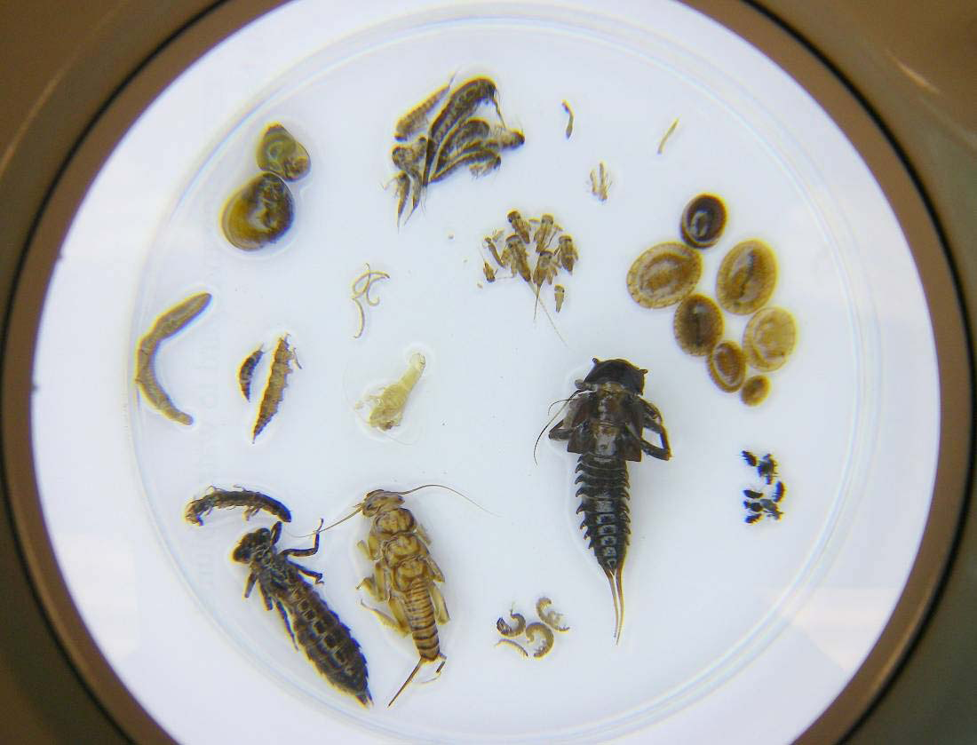
Taxonomic Level of Identification for Benthic Macroinvertebrate Samples – WVSCI
Family Level for WVSCI except for Nematoda and Collembola
All aquatic macroinvertebrates including insects, crustaceans (crayfish, scuds), snails, clams (asian clams, fingernail clams), and worms.

Slide 40
WVDEP WAB QA/QC for Bug Sampling and Bug Identification
2.5% - Duplicates in field samples
5% - Re-identified by a second lab for QA/QC

Slide 41
West Virginia Stream Condition Index (WVSCI)
Gerritson, J., J. Burton, and M.T. Barbour. 2000a. A stream condition index for West Virginia wadeable streams. Tetra Tech, Inc. Owing Mills, MD.
http://www.dep.wv.gov/WWE/watershed/bio_fish/Documents/WVSCI.pdf
http://www.dep.wv.gov/WWE/watershed/bio_fish/Documents/WVSCI%20Addendum.doc
http://www.dep.wv.gov/WWE/watershed/wqmonitoring/Documents/SOP%20Doc/2010%20WAB%20SOP%20Final.pdf

Slide 42
Requirements for Comparable Sample and WVSCI Calculation
Sample collection methods – Follow DEP Watershed Assessment Branch Protocols
Laboratory subsampling - 200 + - 20%
Taxonomic resolution - Family (except Nematoda and Collembola)
Index period – Between April 15 and Oct 15
Tolerance values – DEP WAB database
WVSCI metrics – Use only the 6 family component metrics
Best Standard Values – DEP WAB database

Slide 43
Essential Taxonomic References used by WVDEP WAB
Merritt, R.W., K.W. Cummins, and M.B. Berg, eds. 2008. An Introduction to the aquatic insects of North America. 4th edition/revised edition. Kendall/Hunt Publishing Company, Dubuque, Iowa.
Peckarsky, B.L., P.R. Fraissinet, M.A. Penton, and D.J. Conklin, Jr. 1990. Freshwater macroinvertebrates of northeastern North America. Cornell University Press, Ithaca, New York.
Smith, D. G. 2001. Pennak’s Freshwater Invertebrates of the United States: Porifera to Crustacea. 4th edition. John Wiley & Sons, New York.
Wiggins, G.B. 1996. Larvae of the North American caddisfly genera (Trichoptera). 2nd edition. University of Toronto Press, Toronto, Canada.
Epler, J.H. 2001. Identification manual for the larval Chironomidae (Diptera) of North and South Carolina. North Carolina Department of Environmental and Natural Resources, Division of Water Quality, Raleigh, North Carolina.
Jezerinac, R.F., G.W. Stocker, and D.C. Tarter. 1995. The crayfishes (Decapoda: Cambaridae) of West Virginia. Ohio Biological Survey Bulletin. New Series. Vol. 10, No.1.

