Slide 1
West Virginia’s Vernal Pool Amphibians
Kevin Oxenrider
Amphibian and Reptile Program Leader
West Virginia Division of Natural Resources
Wildlife Resources Section

Slide 2
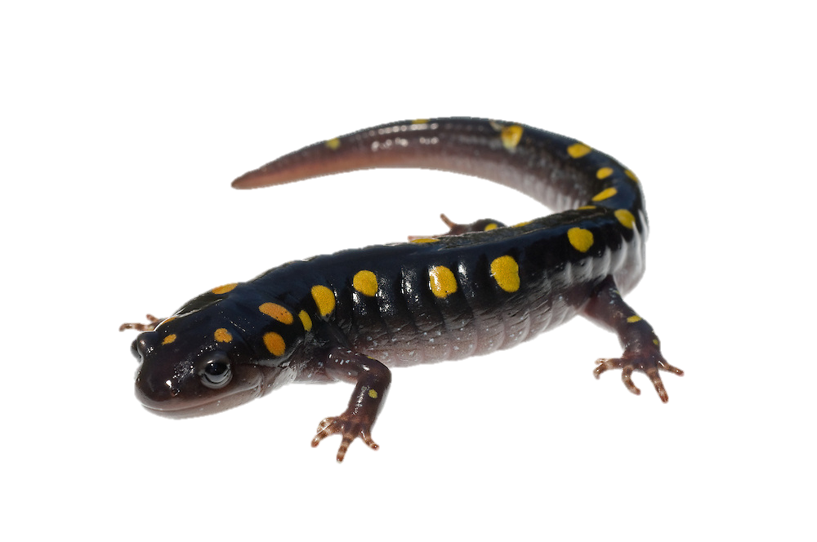
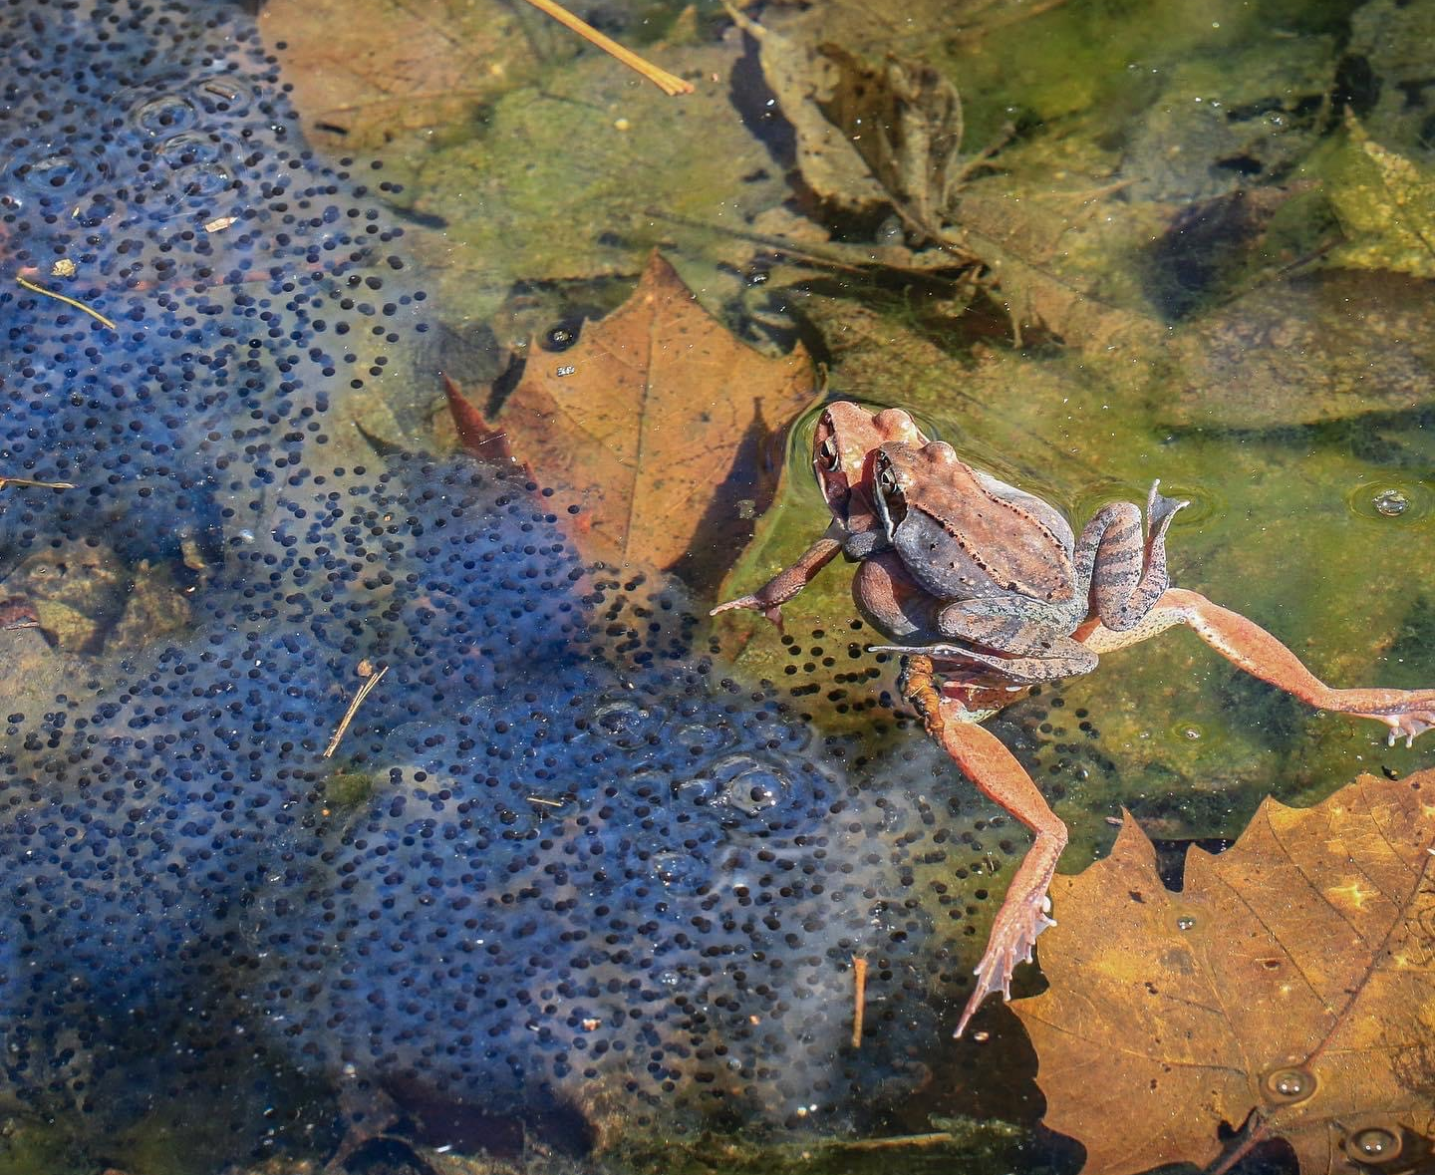
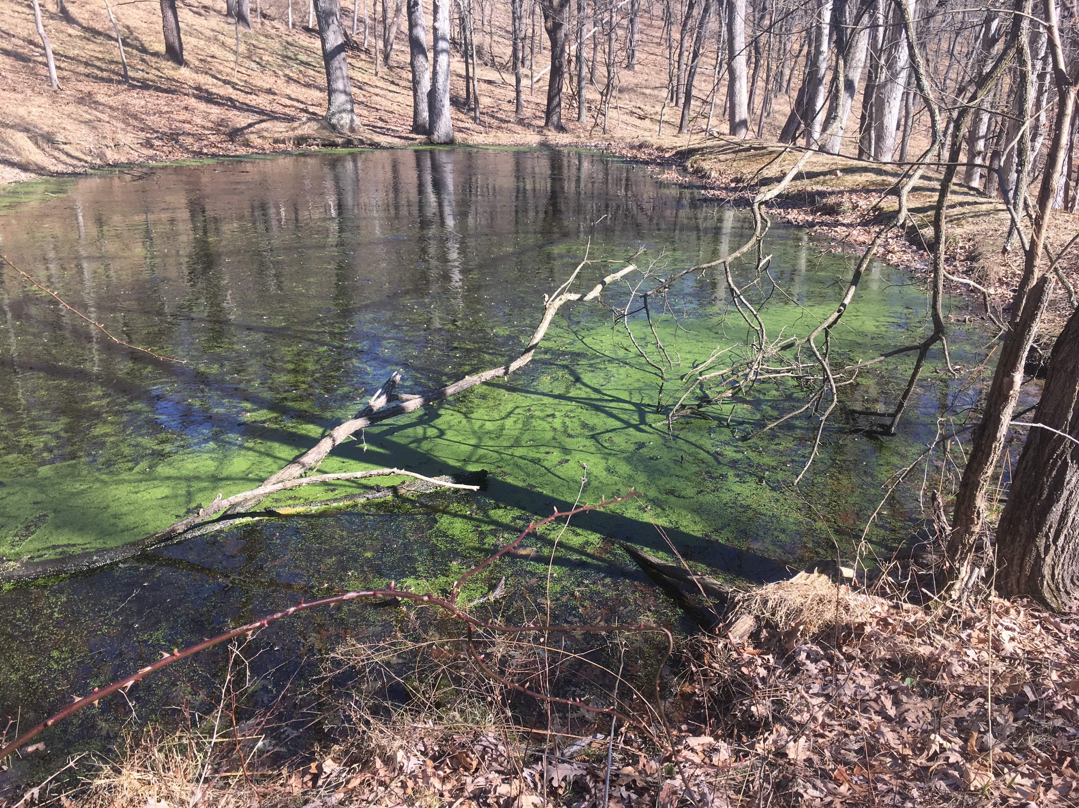
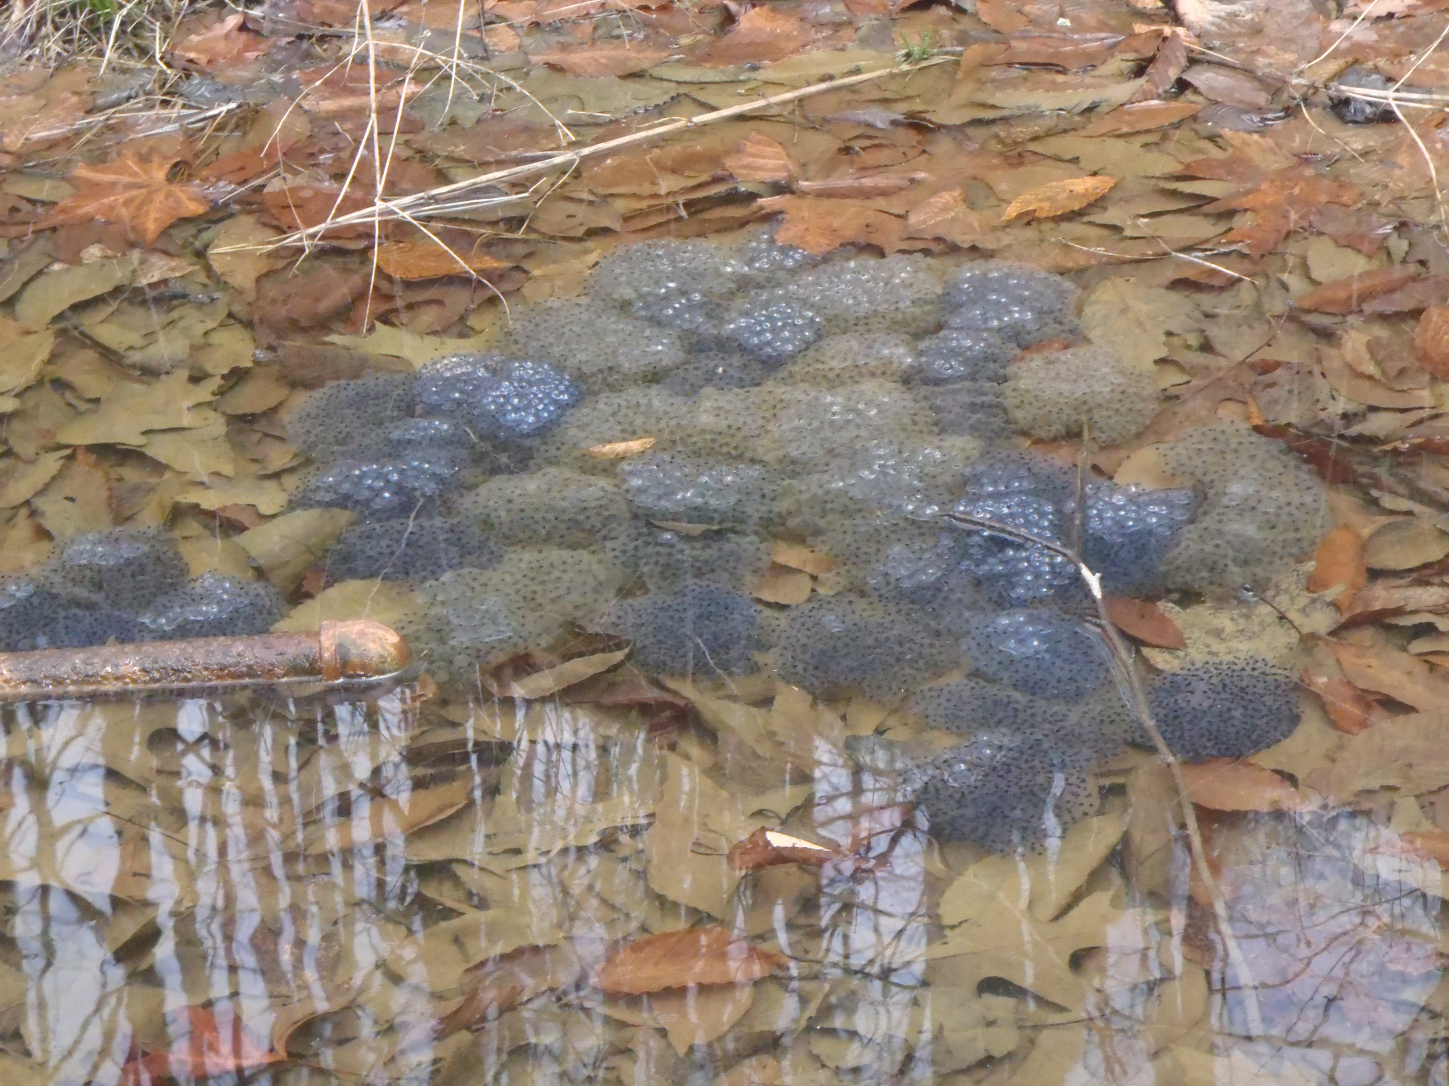
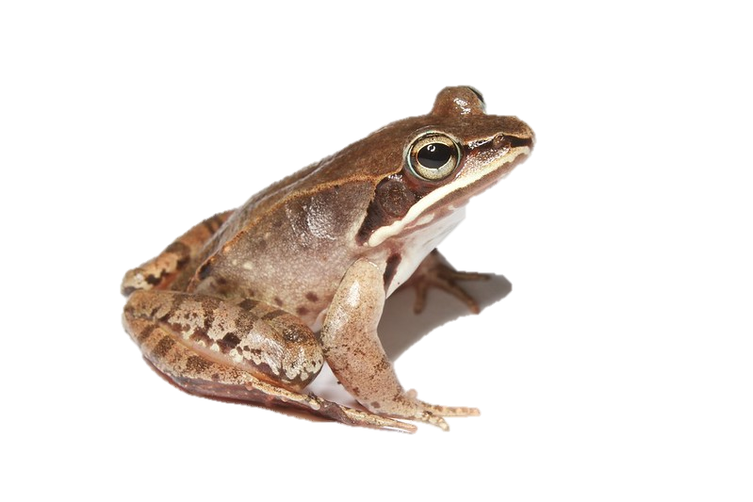
Objectives
What are vernal pools?
Vernal pool amphibian life history
Common vernal pool amphibian identification
Disease risk at vernal pools

Slide 3
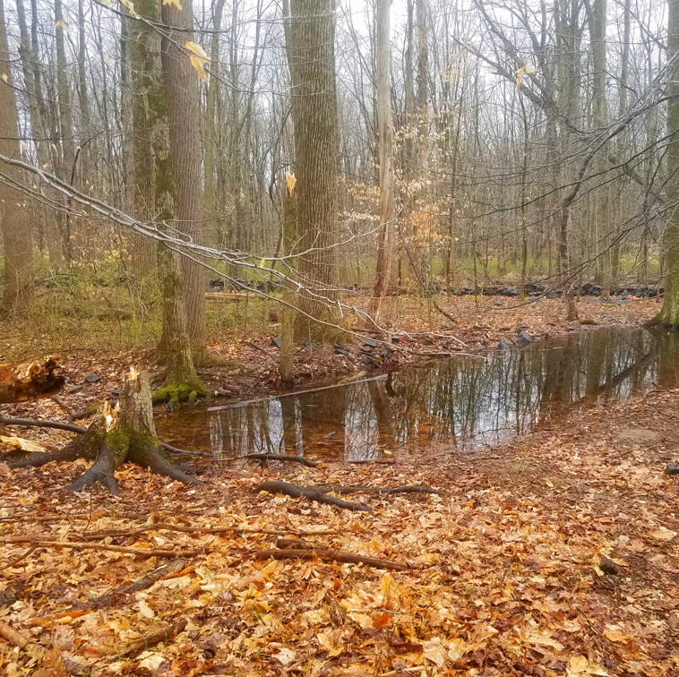
What is a vernal pool?
Shallow depressions that usually contain water for only part of the year
Typically, Winter-Spring
Often forested or associated with forested wetlands
Pools range in size
Lack fish

Slide 4
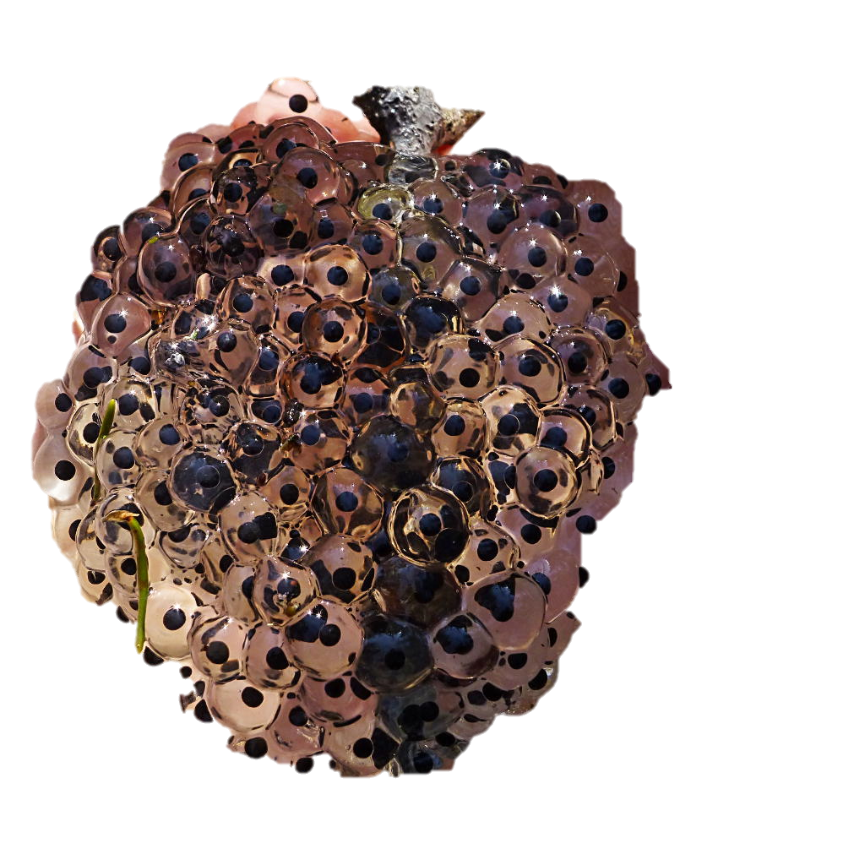
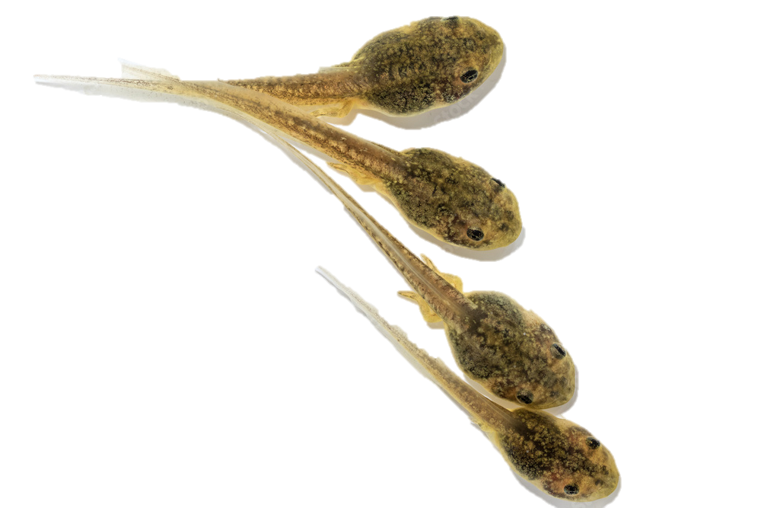
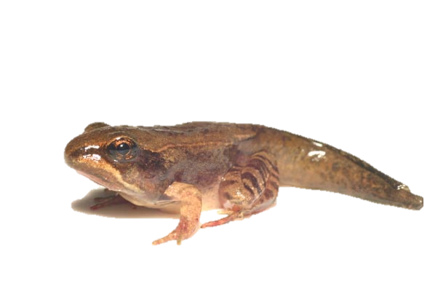
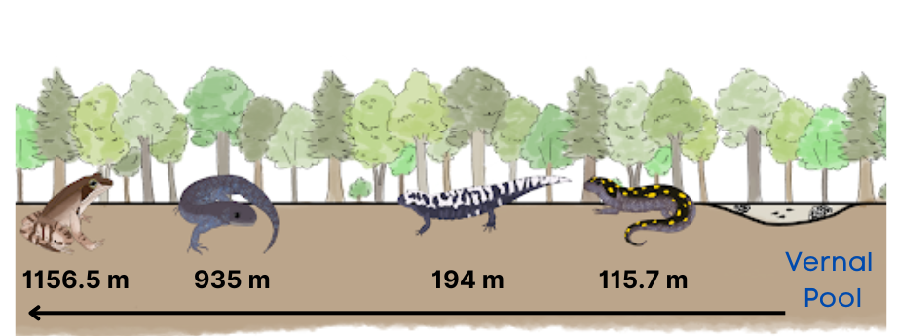
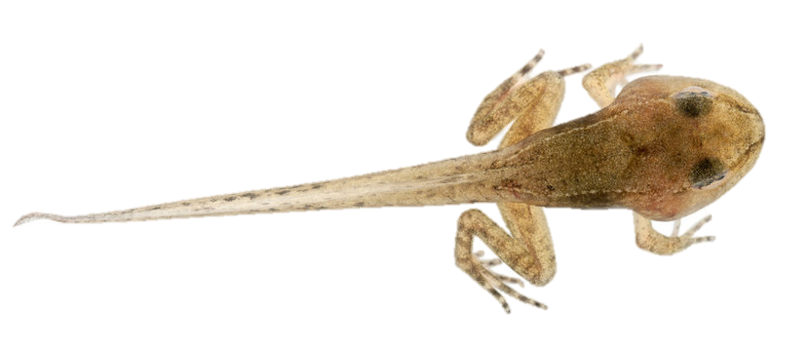
Amphibian Ecology at Vernal Pools
Vernal pools are critical components of some amphibian life cycles
Serve as breeding sites
Tadpole/larvae and juvenile rearing
Adults typically do not disperse far from vernal pools
Metamorphosis
Adults (amplexus/ egg mass laying)
Tadpole/ larvae
Metamorph/ froglet
Adult

Slide 5
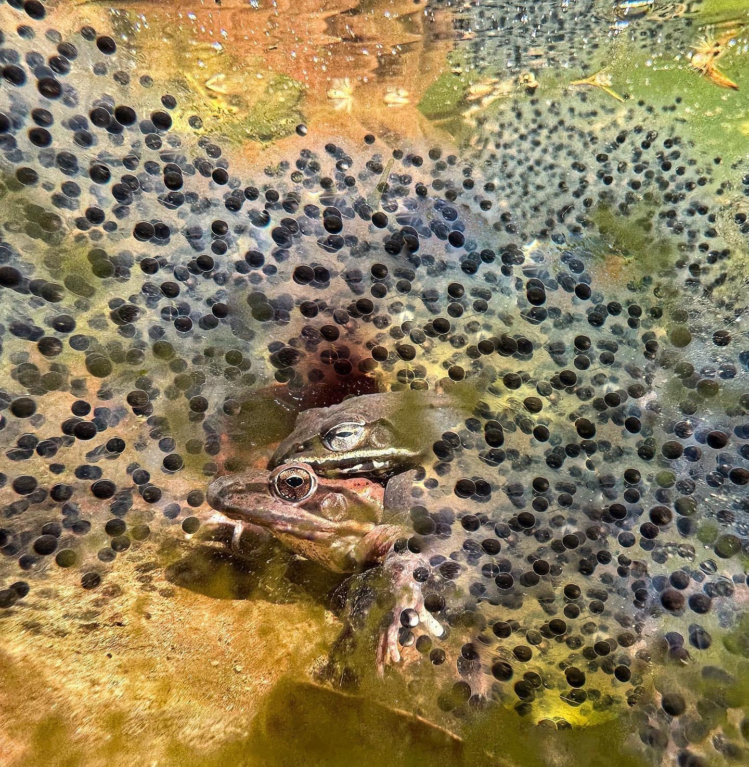
Timing of breeding migrations vary by species
Jeffersons salamander
Wood frog
Spotted salamander
American toad
Gray treefrog
Marbled salamander

Slide 6
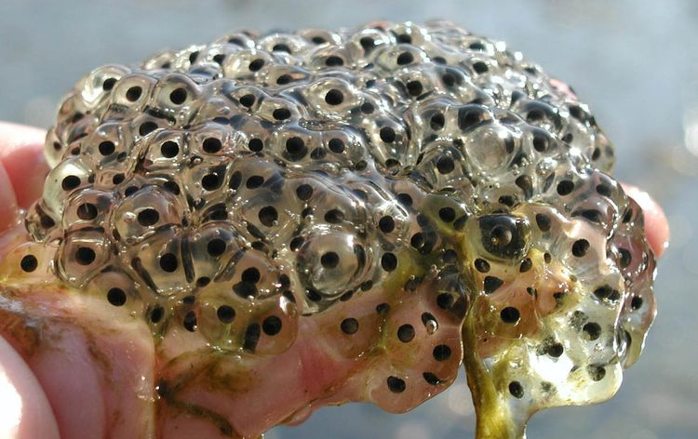
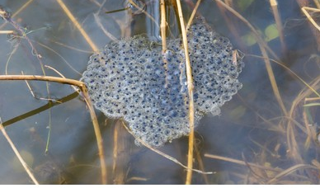
Wood Frog Lithobates sylvaticus
Adult
White upper lip
Black triangular “mask” behind eye
Dorsolateral ridges
Egg Mass
Gelatenous
Grapes
Attached to sticks and vegetation in the water
Call
Squeaky shoes or “wonky” duck

Slide 7
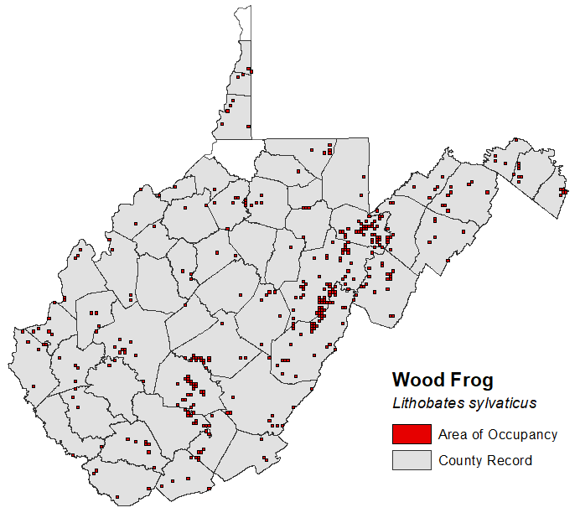

Slide 8
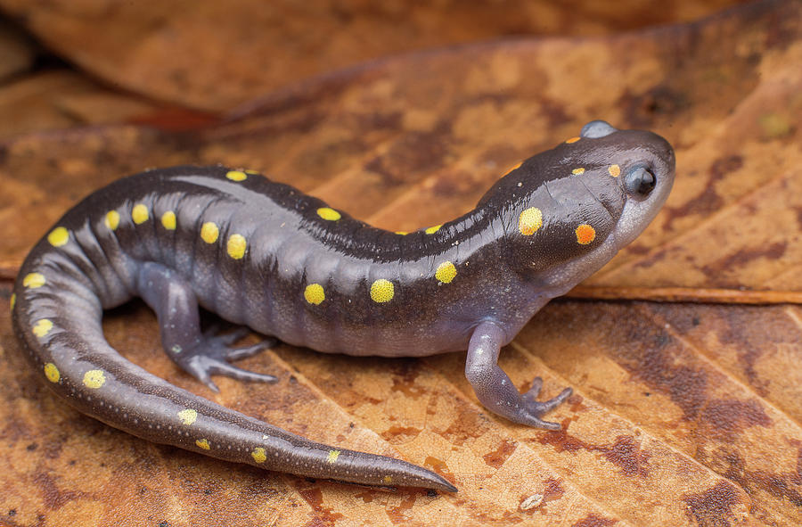
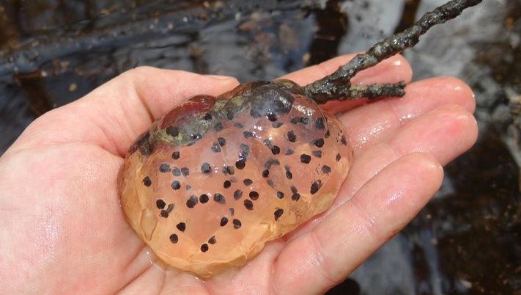
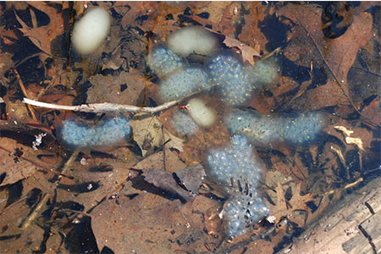
Spotted Salamander Ambystoma maculatum
Adult
Large, thick salamander
Black to gray overall
Yellow spots on back
Pale gray on belly
No spots on belly
Egg Mass
Globular
Clear or white in color
Masses attached to submerged sticks, vegetation, or the pool bottom

Slide 9
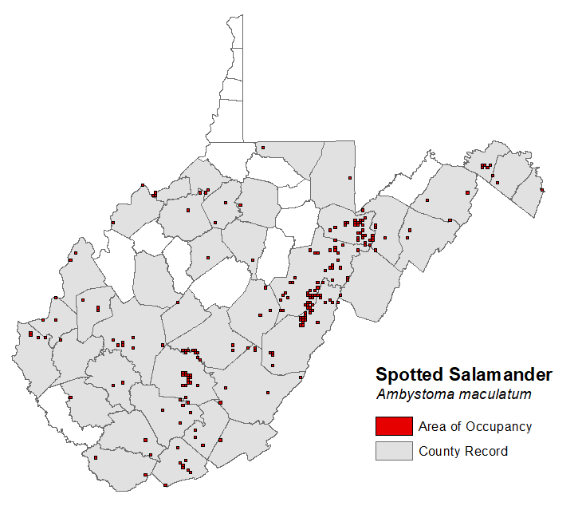

Slide 10
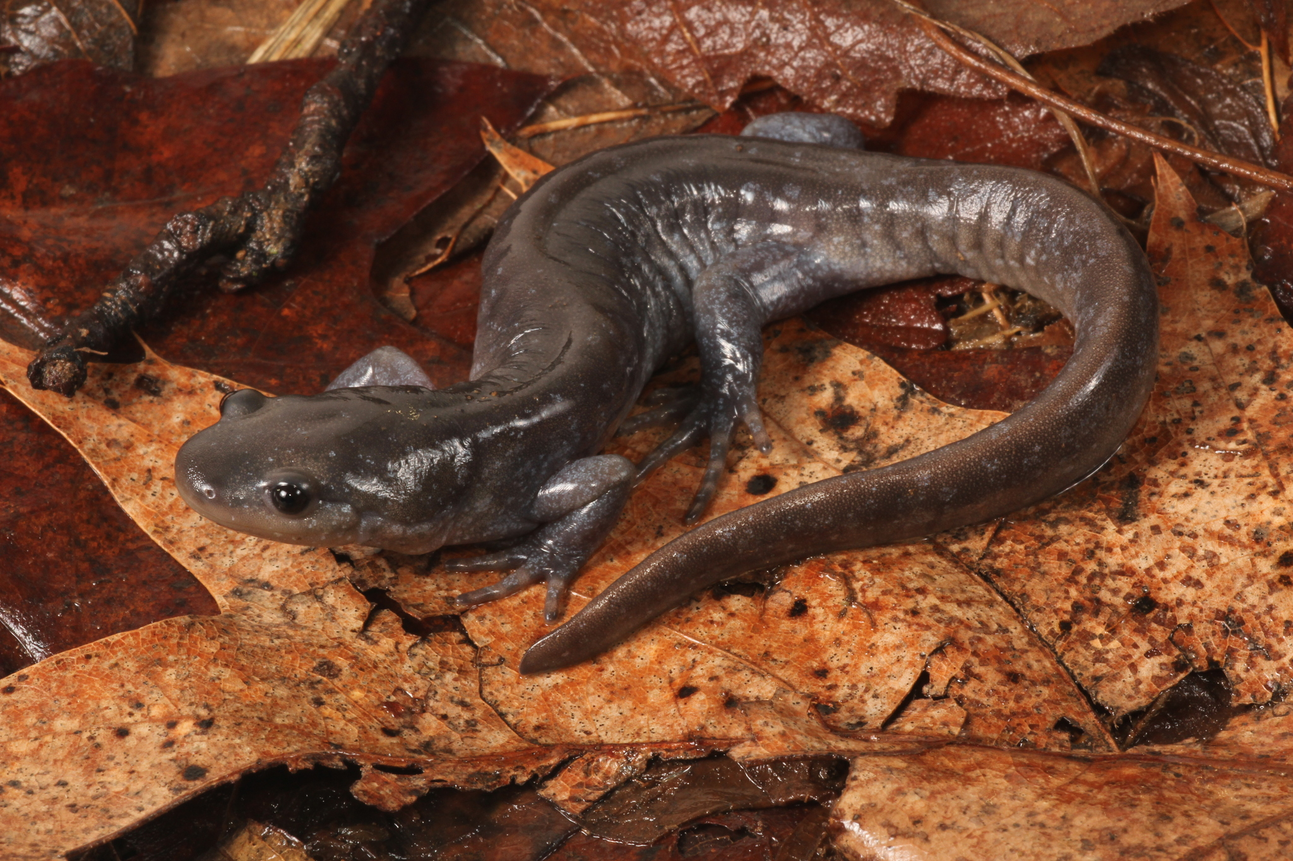
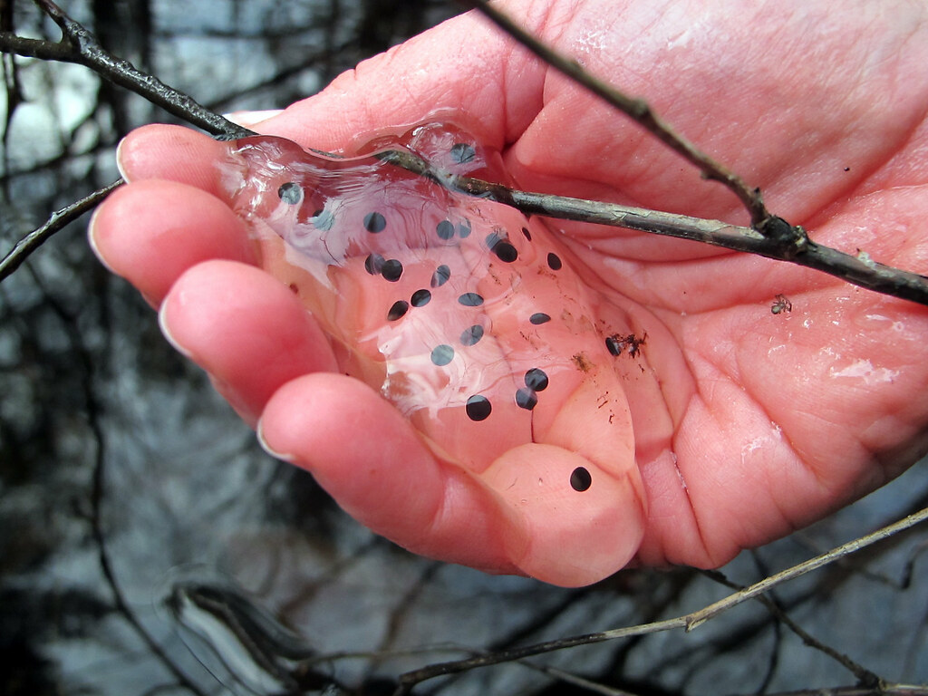
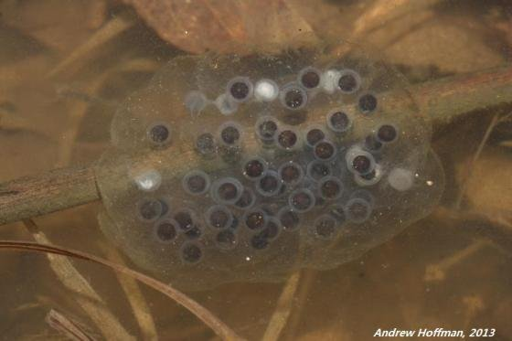
Jeffersons Salamander Ambystoma jeffersonianum
Adult
Large salamander
Black to gray overall
Pale blue flecks may be on sides
Elongated toes
Especially hind feet
Egg Mass
Globular
Clear in color
Masses typically attached to submerged sticks/twigs

Slide 11
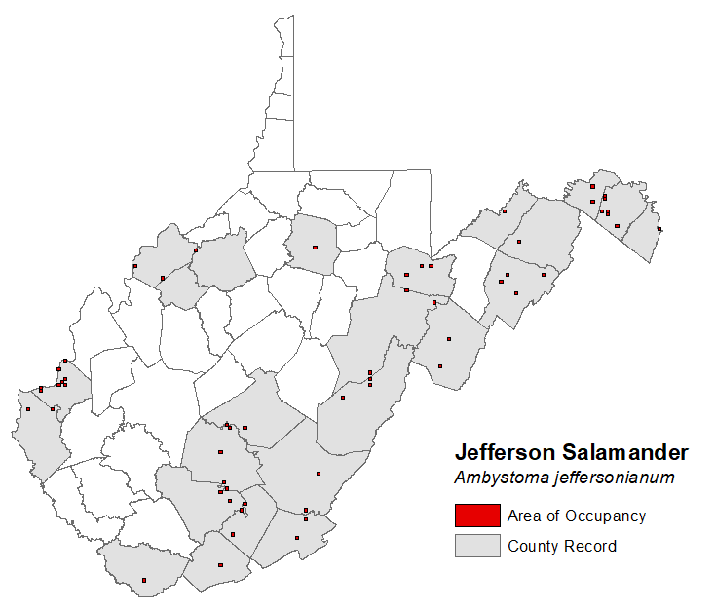

Slide 12
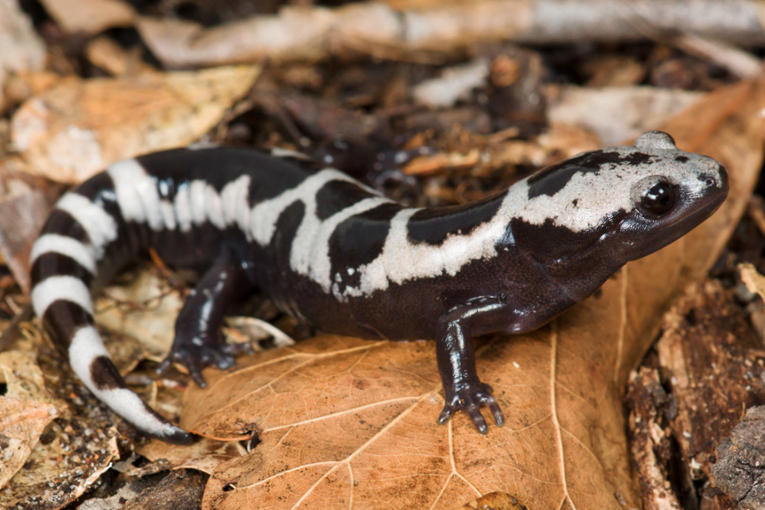
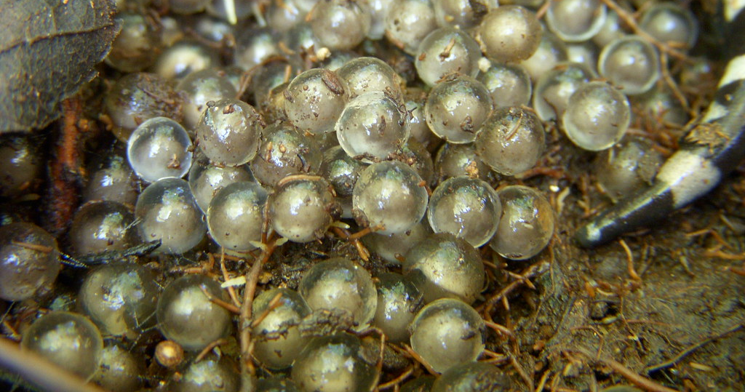
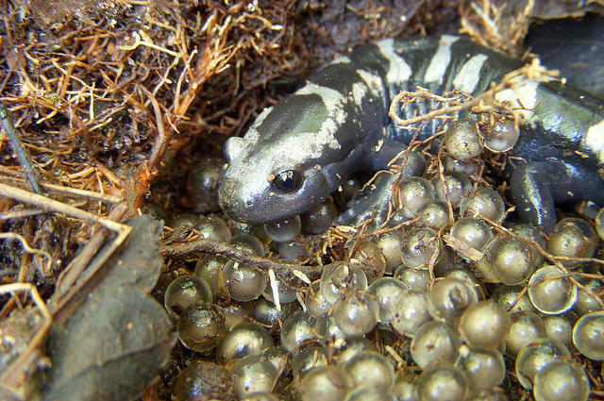
Marbeled Salamander Ambystoma opacum
Adult
Large, thick salamander
Black with white netting/crossbands on back
Black or pale gray belly
Eggs
Laid in dry vernal pools, under logs, leaves, or other structure, in Autumn (September/October)
Nests guarded by female
Eggs not contained in globular mass

Slide 13
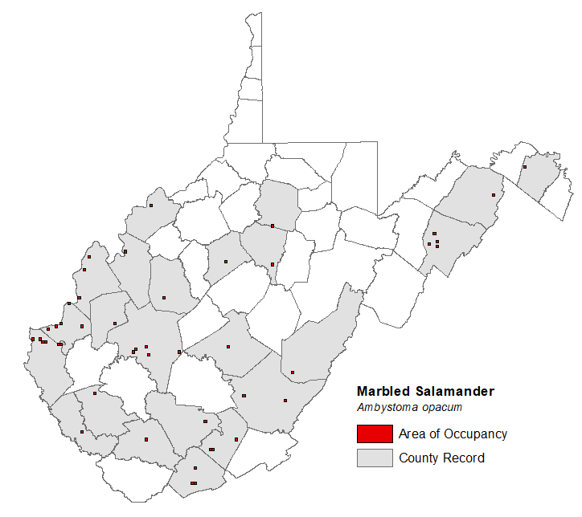

Slide 14
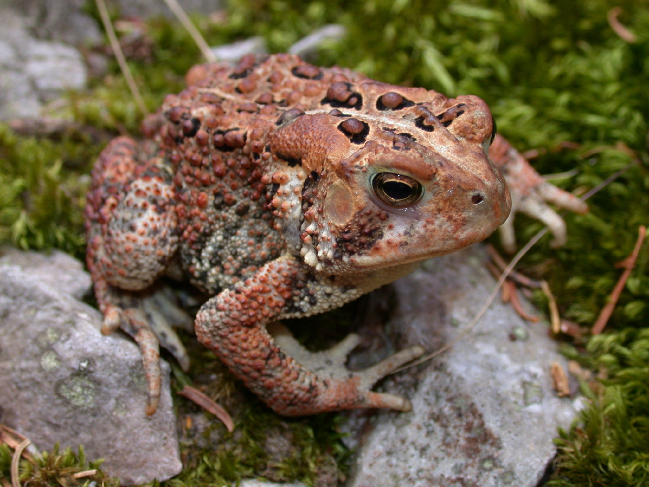
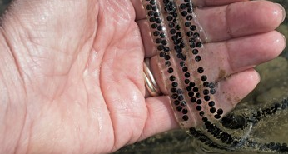
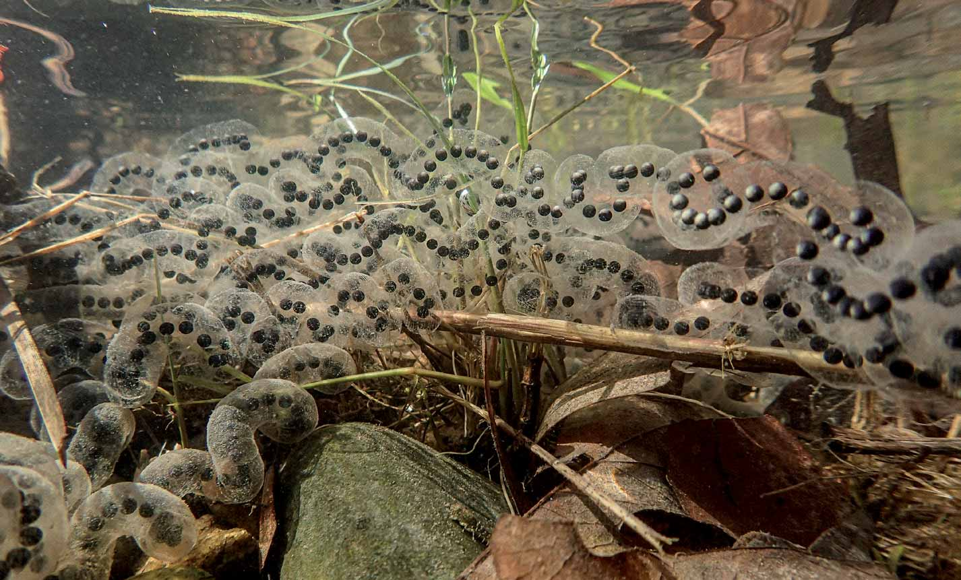
American Toad Anaxyrus americanus
Adult
Typically, brown or gray in coloration
Dark patches on back contain bumps (warts)
Parotoid glands located behind eyes
Release toxin when touched
Egg Mass
Laid in long, thin, often coiled masses
Call
Long trill

Slide 15
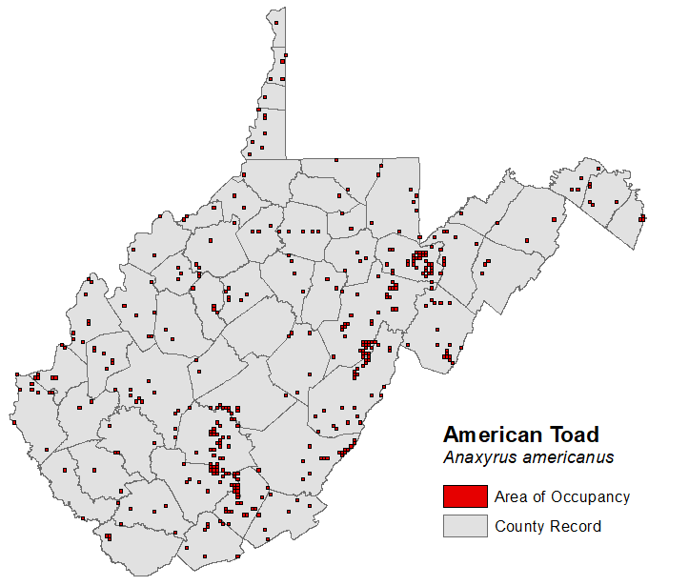

Slide 16
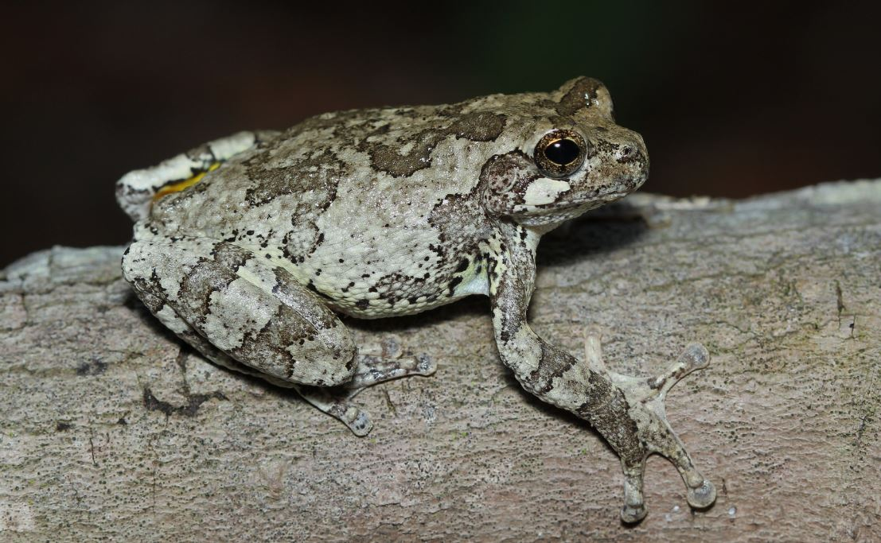
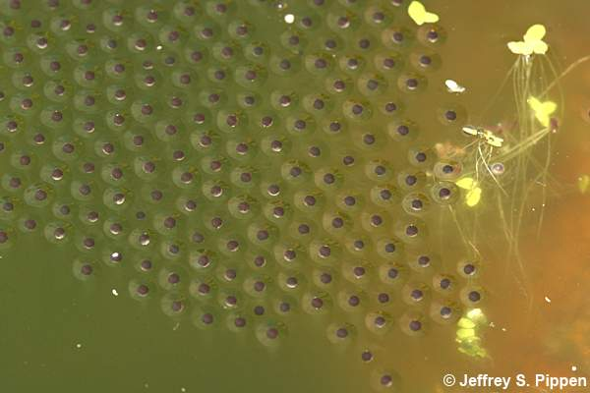
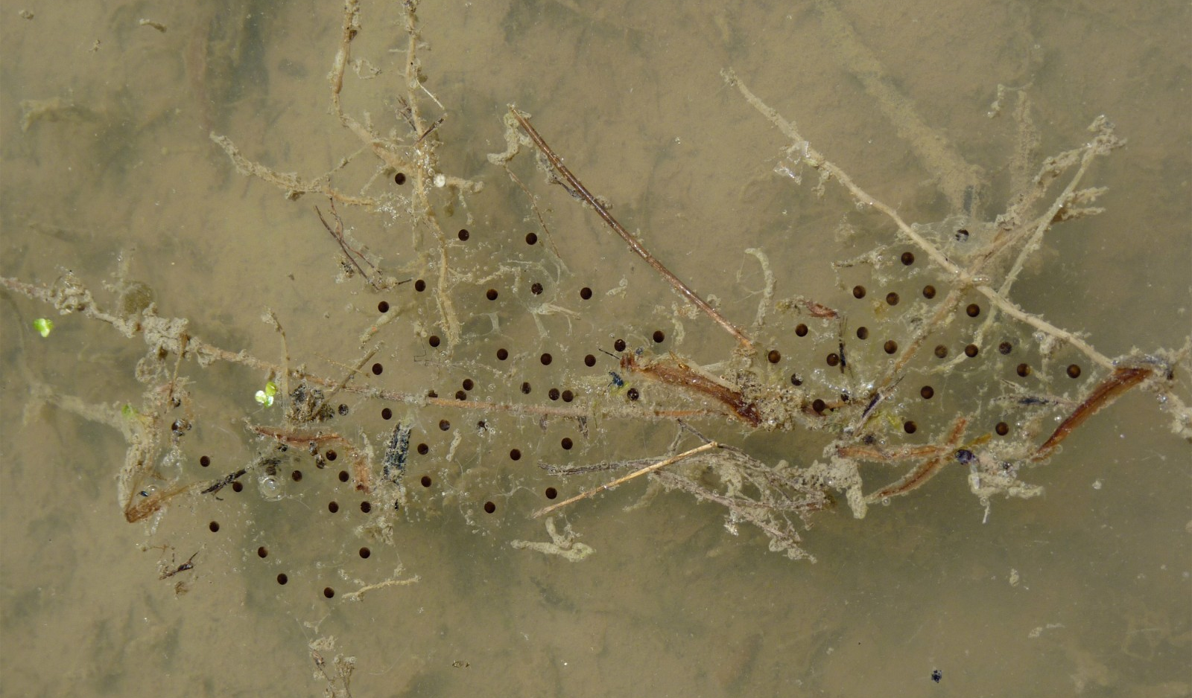
Gray Treefrog/ Cope’s Gray Treefrog Hyla versicolor/ H. chrysoscelis
Adult
Vary in color from mottled gray to green
Large toepads
Yellow inner thighs
Egg Mass
Eggs laid in thin film-like mass on water surface
Call
Short, bird-like trill

Slide 17
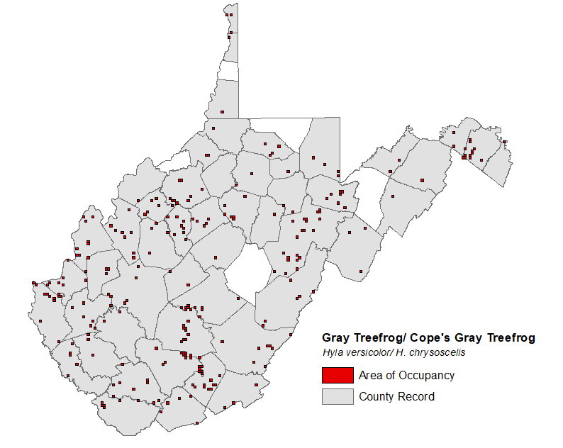

Slide 18
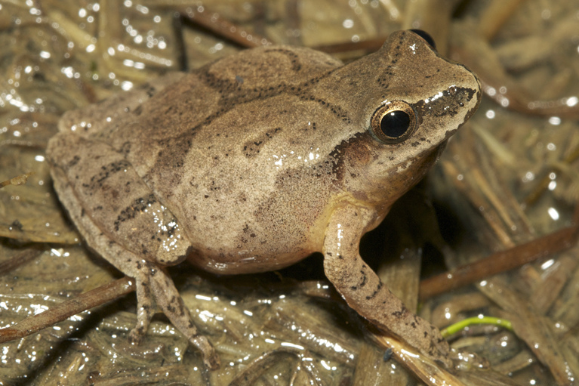
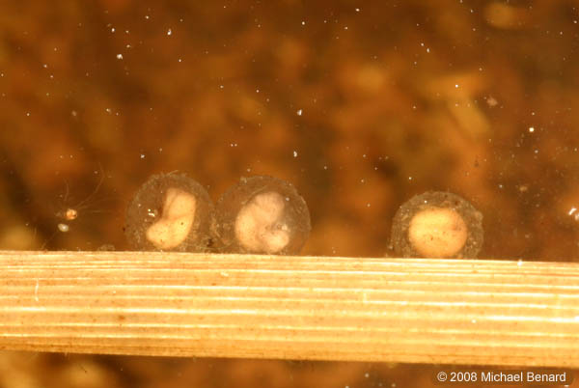
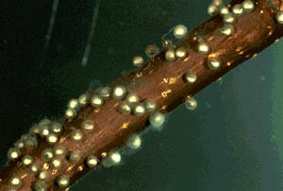
Spring Peeper Pseudacris crucifer
Adult
Small frog
Light brown to pale olive coloration with darker brown markings on back
“X” marking on back
Egg Mass
Eggs deposited singly or in small clumps on submerged vegetation
Call
Bird-like “peep”

Slide 19
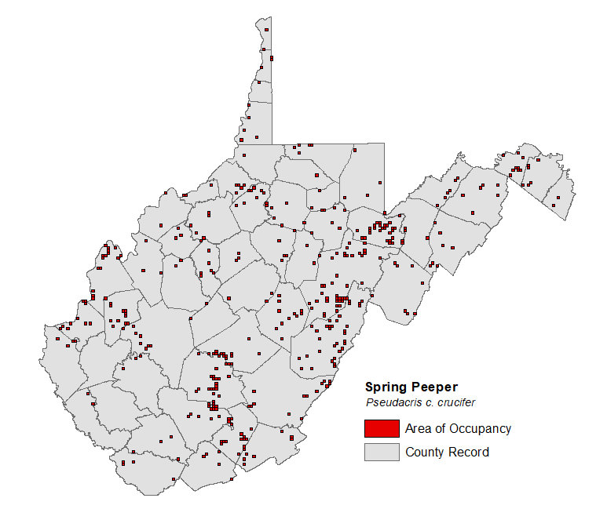

Slide 20
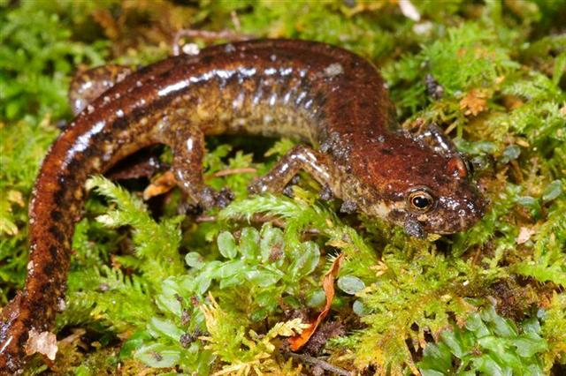
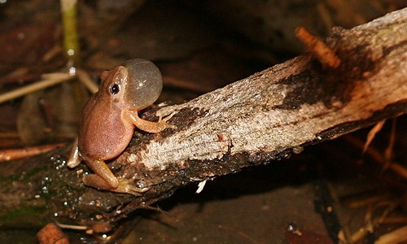
Amphibians Declining
Leading cause is habitat destruction and emerging diseases.
What are Emerging Diseases?
A disease that has increased in the past 20 years and could increase in the near future.
Emerging diseases impacting amphibians and reptiles
Ranaviruses
Chytrid fungus
Vernal pools present an elevated risk due to concentrating animals.

Slide 21
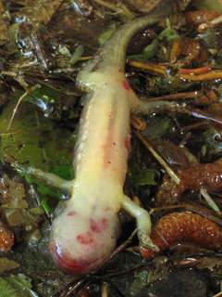
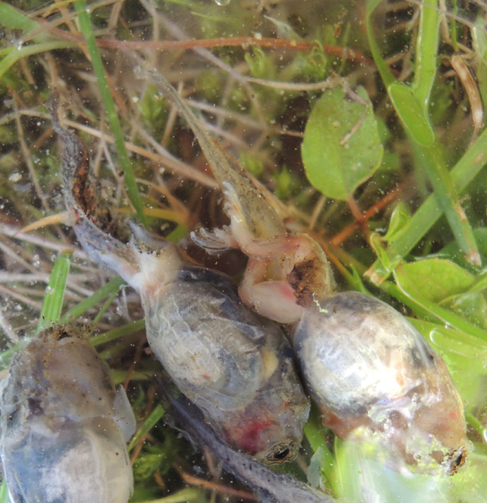
Ranaviruses
Viral disease that can impact amphibians, reptiles, and fishes.
Very detrimental in ephemeral wetlands
First isolated from northern leopard frogs in 1960
Mass mortality events have occurred in over 20 US states
Mass mortality events can impact local populations, range-wide population impacts still unknown
Routes of Transmission
Indirect contact (water or sediment contact with epithelial cells in the skin, gills, or intestines)
Direct contact (during breeding or other social interactions)
Ingestion (depredation)

Slide 22
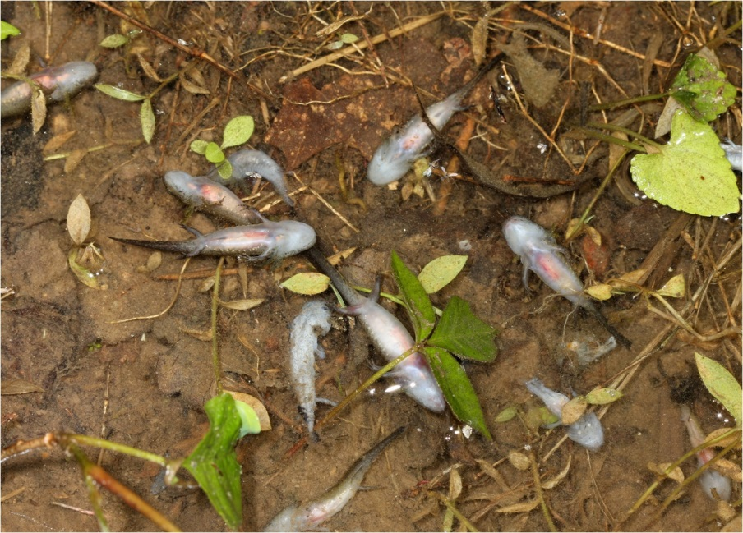
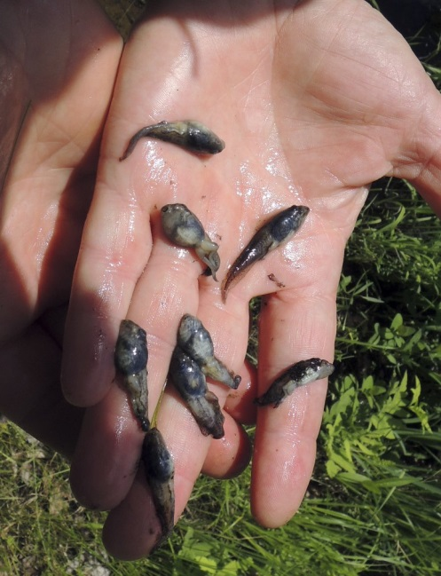
Ranaviruses cont.
Can cause 50%-99% mortality in larval amphibians.
Wood frogs are thought to be most susceptible
Has been detected in WV

Slide 23
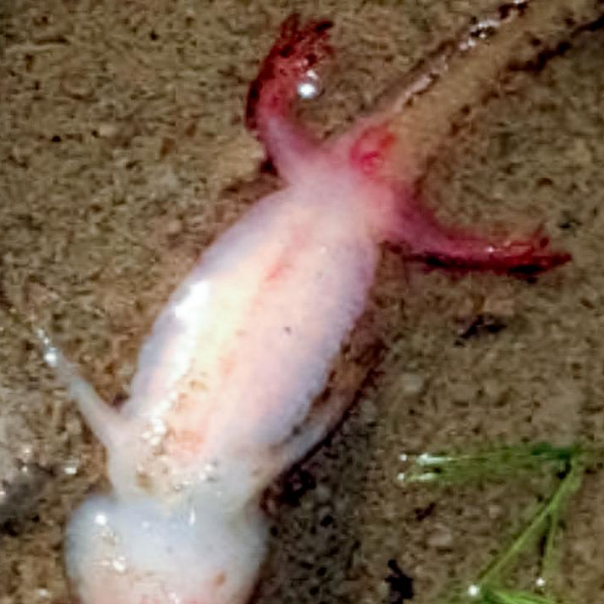
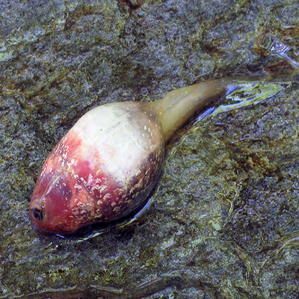
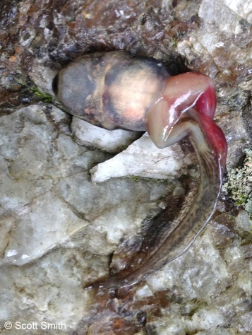
Clinical Signs of Ranavirus
Swelling of legs and body
Internal hemorrhaging
Redness of the legs and vent
White plaque in the mouth, swollen eyes, and wheezing in reptiles

Slide 24
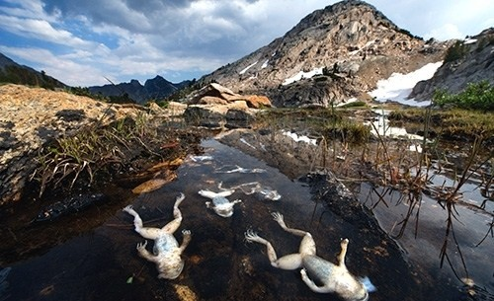
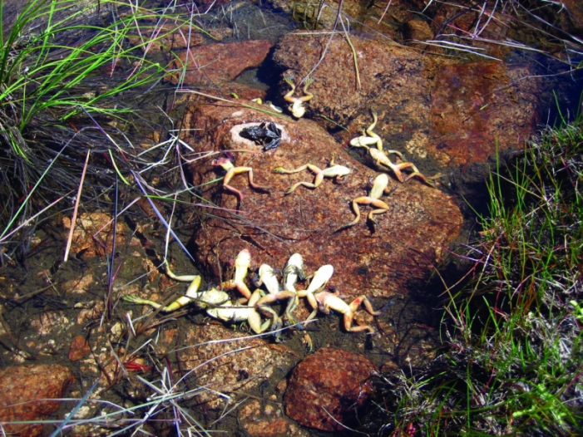
Chytrid Fungus
Fungal disease only known to impact amphibians
Has caused large-scale population declines
2 species of chytrid fungus
Bd Bsal

Slide 25
Batrachochytrium dendrobatidis (Bd)
Leading cause of amphibian decline worldwide
Aquatic zoosporic fungi
Infects skin and causes skin lesions, anorexia, apathy, and death
Routes of Transmission
Direct contact (social interactions; zoospore flagellum)
Has been detected in WV

Slide 26
Clinical Signs of Bd
Reddening of the skin
Excessive shedding of the skin
Unusual posturing

Slide 27
Batrachochytrium salamandrivorans (Bsal)
Aquatic zoosporic fungi
Discovered in 2013
Not in North America yet
Only believed to impact salamanders, but other amphibians are carriers
Routes of transmission same as Bd

Slide 29
Questions?

